Slide 1
Group3
Security Ananlysis on NSL-KDD dataset
Xiecongyou Yang, Yuannan Yang, Siqi Cao
(https://github.com/xcyyang/SA-group3)

Slide 2
Agenda
Problem Definition
Introduction to NSL-KDD dataset
Models & Techniques
Binary Labels Classification
Multiple Labels Classification

Slide 3
Problem Definition
As rapidly growth of internet attacks, intrusion detection is of great significance to cyber security. To better detect and predict the forthcoming attacks, we apply machine learning techniques.
Our main goal is to design the model that is capable of distinguishing between anomaly packets and normal packets, and furthermore, predicting incoming packets’ label.

Slide 4
Introduction to NSL-KDD dataset
NSL-KDD dataset is an improved version of the previous KDD 1999 Dataset, which contains four sub datasets(KDDTest+, KDDTest-21, KDDTrain+, KDDTrain+_20Percent). Specifically, the KDDTest-21 (without the most difficult traffic records) and KDDTrain+_20Percent(20% of entire train dataset) are subsets of the KDDTrain+ and KDDTest+.
There are total 148517 records of internet traffic of simple intrusion detection in the entire dataset, which contain 43 features per record. 41 features are for traffic input and the last two are labels (normal or attack) and Score (the severity of the traffic input).

Slide 5
Models & Techniques
Data preprocessing
One-Hot-Encoding; Standardization
Feature Selection
PCA / Anova F-test
Cross Validate
K-Fold
Model Selection
Decison tree / Logistic Regression / SVM
Evaluation
Accuracy; Precision, Recall, f1_score, Roc_auc

Slide 6
Data preprocessing
One-Hot-Encoding can transform all categorical features into binary features. Library sklearn.preprocessing provides a convenient way to use OneHotEncoder to make all features into numerical binaries.
Next is to standardize the features by removing the mean and scaling to unit variance, in order to make sure that some features can be compared to other features. Likewise, standardScaler() from sklearn.preprocessing accelerate our project.
According to .arff files, the test dataset has fewer features than the train dataset. We have to add these missing features to the test dataset before training.

Slide 7
Feature Selection
Feature Selection is to eliminate redundant and irrelevant data by selecting a subset of relevant features that fully represents the given problem. To fulfill this goal, we apply PCA and Anova F-test.
PCA (Principal Component Analysis): Use PCA to reduce dimensionality. Set n_components from 0.1 to 0.9 to control the number of selected features
ANOVA F-test: Compute ANOVA F-value between label/feature for classification tasks, and use SelectPercentile to keep specific percent of features

Slide 8
Model Selection
Decision Tree: sklearn.tree.DecisionTreeClassifier.
Logistic Regression: sklearn.linear_model.LogisticRegression. In the multiclass case, the training algorithm uses the one-vs-rest (OvR) scheme if the ‘multi_class’ option is set to ‘ovr’, and uses the cross-entropy loss if the ‘multi_class’ option is set to ‘multinomial’
SVM: sklearn.svm.LinearSVC. This class supports both dense and sparse input and the multiclass support is handled according to a one-vs-the-rest scheme.

Slide 9
Evaluation
Using the test data to make predictions of the model. Multiple scores are considered such as: accuracy score, recall, f-measure, confusion matrix.
Accuracy. sklearn.metrics.accuracy_score. To compute the test dataset’s accuracy, comparing the predicted labels with actual labels in test datasets.
ROC (receiver operating characteristic) curves and AUC: sklearn.metrics.roc_auc_score. This class computes the area under the ROC curve, to reflect the relationship between true positive rate and false positive rate.
PRC (Receiver Operating Characteristic): sklearn.metrics.f1_score. The F1 score can be interpreted as a weighted average of the precision and recall, where an F1 score reaches its best value at 1 and worst score at 0.

Slide 10
Binary Labels - Decision Tree
Standardize
PCA/ANOVA F-test
n_component / percentile: 0.7, 0.8, 0.9
Cross Validate
K-Fold: 5
Decision Tree
depth: 10, 20, None
Evaluation
accuracy, precision, recall, f1_score, roc_auc

Slide 11
Binary Labels - Logistic Regression
Standardize
PCA/ANOVA F-test
n_component / percentile: 0.7, 0.8, 0.9
Cross Validate
K-Fold: 5
Logistic Regression
solver: newton-cg, lbfgs, sag
Evaluation
accuracy, precision, recall, f1_score, roc_auc

Slide 12
Binary Labels - SVM
Standardize
PCA/ANOVA F-test
n_component / percentile: 0.7, 0.8, 0.9
Cross Validate
K-Fold: 5
SVM
C_selection: 0.5, 1, 10, 100, 1000
kernel: poly, rbf, sigmoid
Evaluation
accuracy, precision, recall, f1_score, roc_auc

Slide 13
Binary
Training set:
Total Records: 103961
Anomaly Records: 50007 (48%)
Testing set:
Total Records: 44556
Anomaly Records: 21456(48%)
negative: normal
positive: anomaly

Slide 14
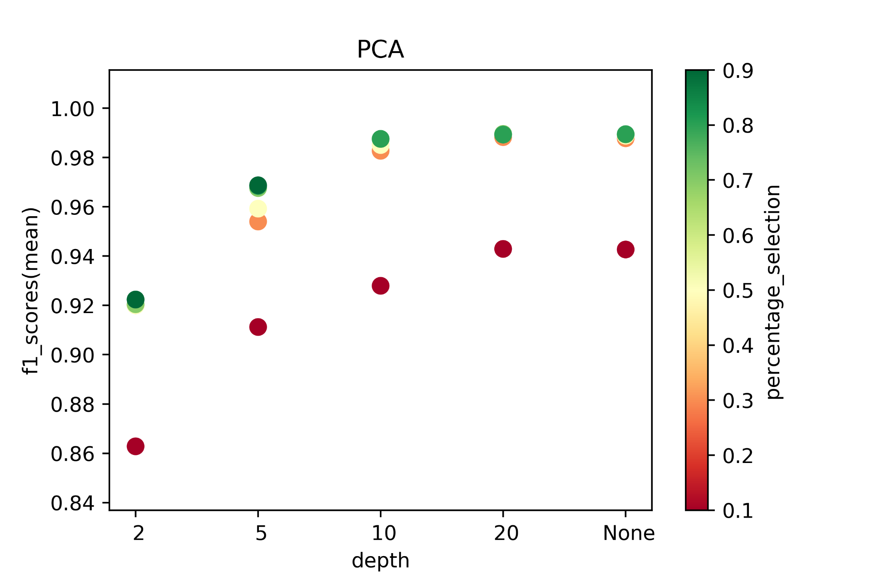
Binary - Decision Tree
Conclusion: PCA + 20 depth + 0.8 percentage => Higher f1_score

Slide 15
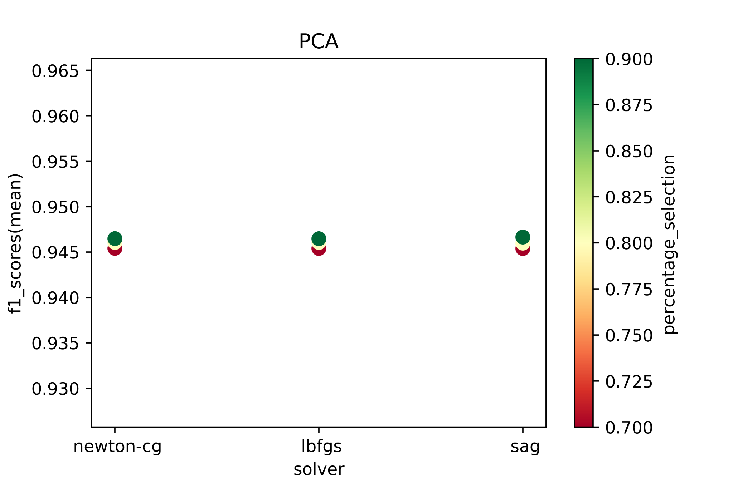
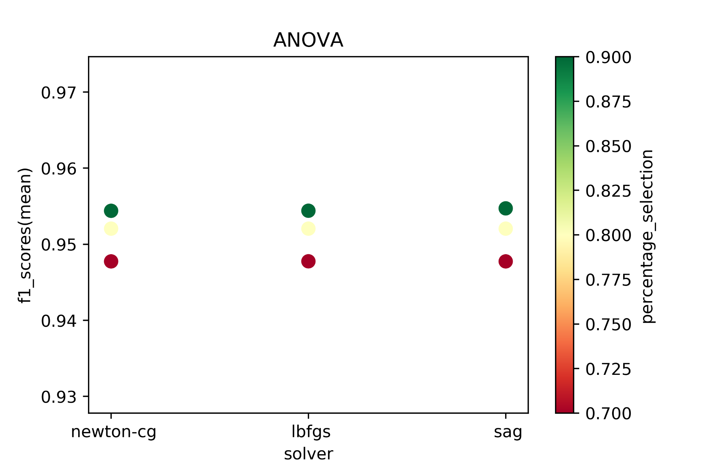
Binary - Logistic Regression
Conclusion: Almost the same, except for selection percentage.

Slide 16
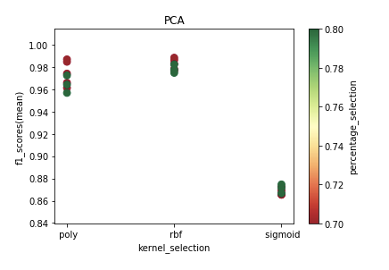
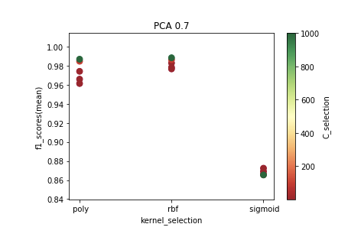
Binary - SVM
Conclusion: For PCA, bigger percentage may result in smaller f1_scores.
When PCA = 0.7, the higer c_selection, the better.

Slide 17
Multiple Labels
DoS
Probe
Anomaly
Remote To Local
User To Root

Slide 18
Multiple Labels (Separately) - Decision Tree
Standardize
PCA/ANOVA F-test
n_component / percentile: 0.1 ~ 0.9
Cross Validate
K-Fold: 5
Decision Tree
depth: 2, 5, 10, 20, None
Evaluation
accuracy, precision, recall, f1_score, roc_auc

Slide 19
Multiple Labels (Separately) - Logistic Regression
Standardize
PCA/ANOVA F-test
n_component / percentile: 0.1 ~ 0.9
Cross Validate
K-Fold: 5
Logistic Regression
solver: newton-cg, lbfgs, sag
Evaluation
accuracy, precision, recall, f1_score, roc_auc

Slide 20
Multiple Labels (Separately) - SVM
Standardize
PCA/ANOVA F-test
n_component / percentile: 0.1 ~ 0.9
Cross Validate
K-Fold: 5
SVM
C_selection: 0.2, 0.5, 1, 2, 5, 10, 100, 1000, 10000
kernel: poly, rbf, sigmoid
Evaluation
accuracy, precision, recall, f1_score, roc_auc

Slide 21
DoS (Denial of Service)
Training set:
Total Records: 91308
DoS Records: 37364(40.92%)
Testing set:
Total Records: 39133
DoS Records: 16023(40.94%)
Definition: Block or restrict a computer system or network resources or services
negative: normal
positive: neptune, back, land, pod,smurf, teardrop, mailbomb, apache, processtable, udpstorm, worm

Slide 22
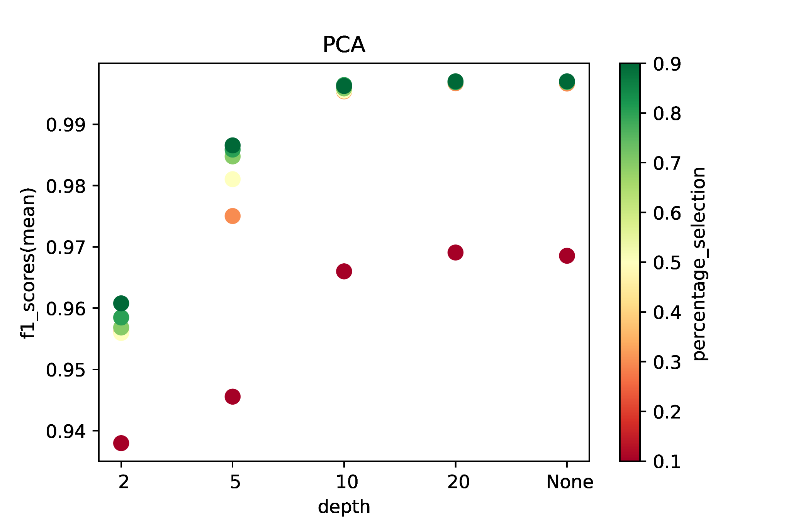
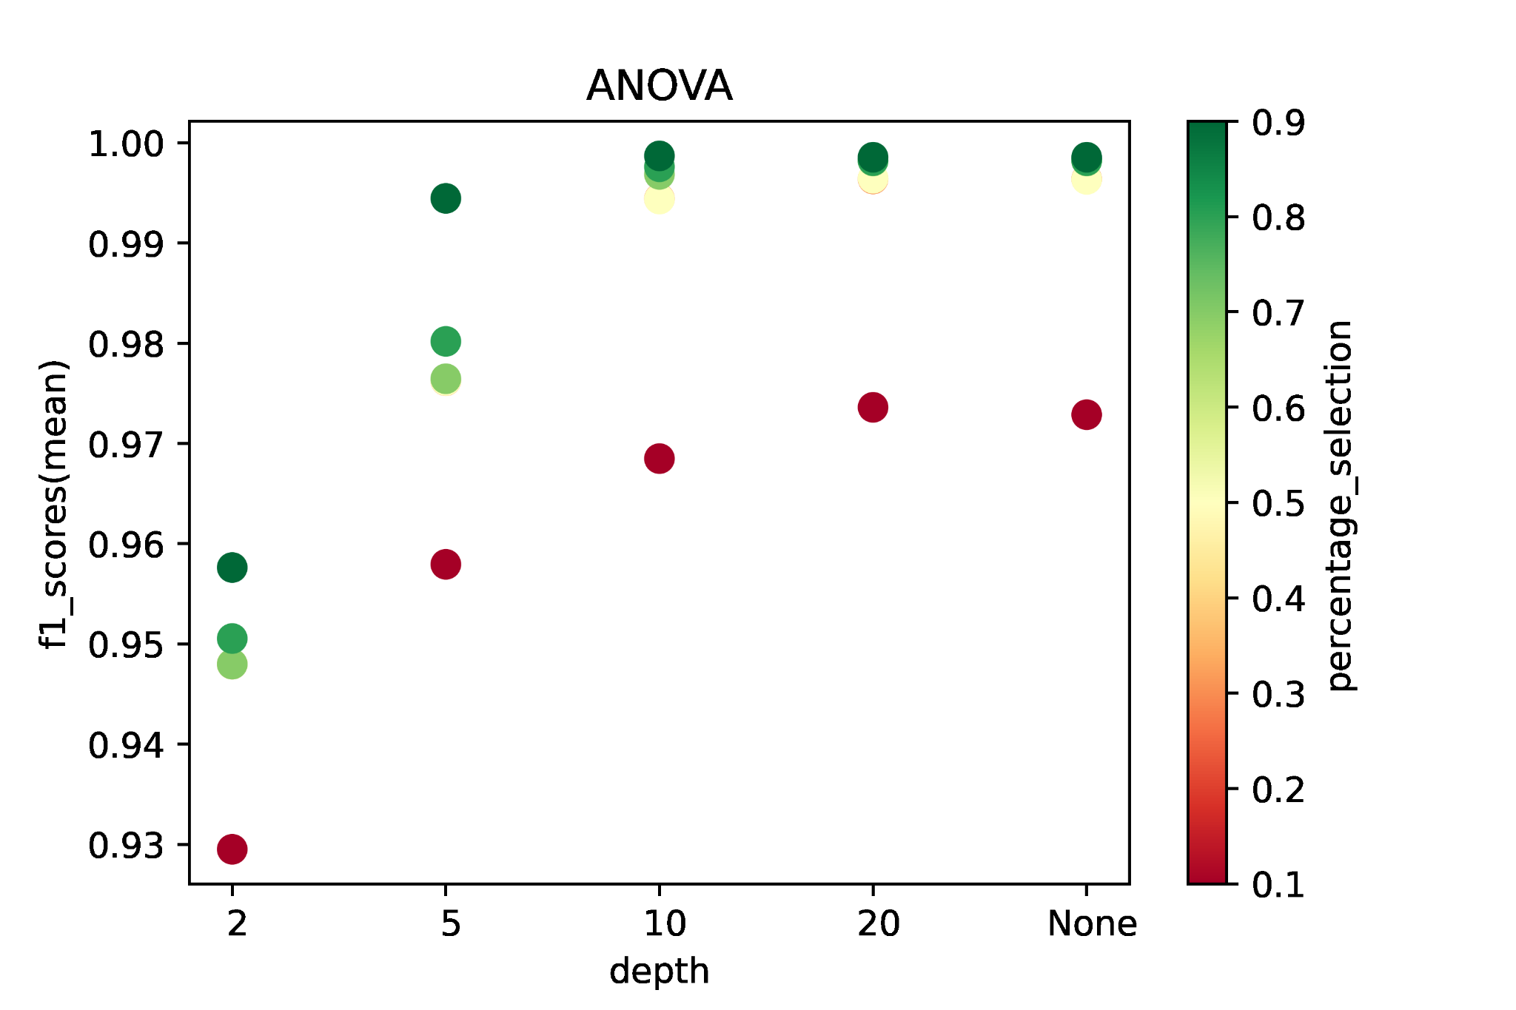
DoS - Decision Tree
Conclusion: ANOVA + Higher depth + Higher percentage => Higher f1_score

Slide 23
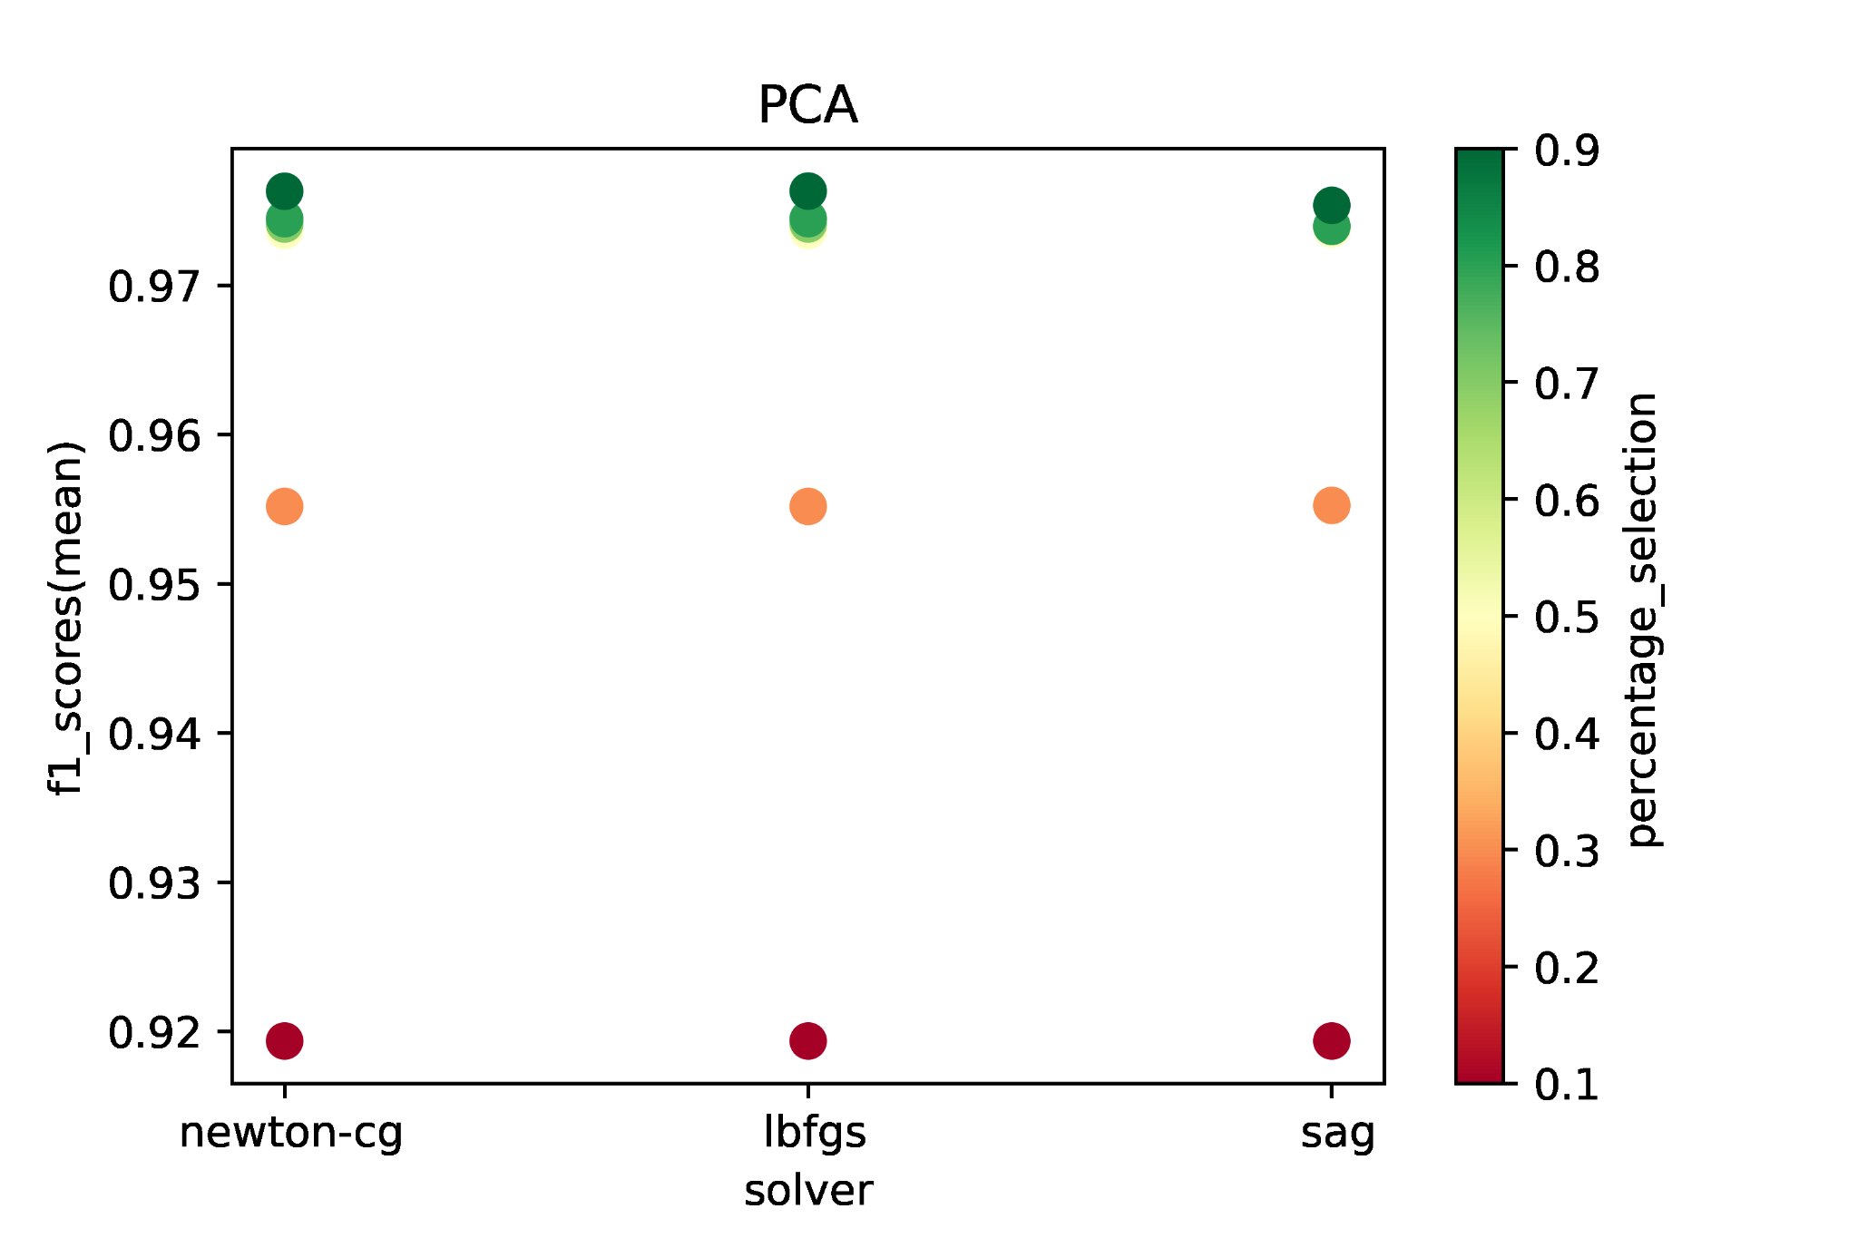
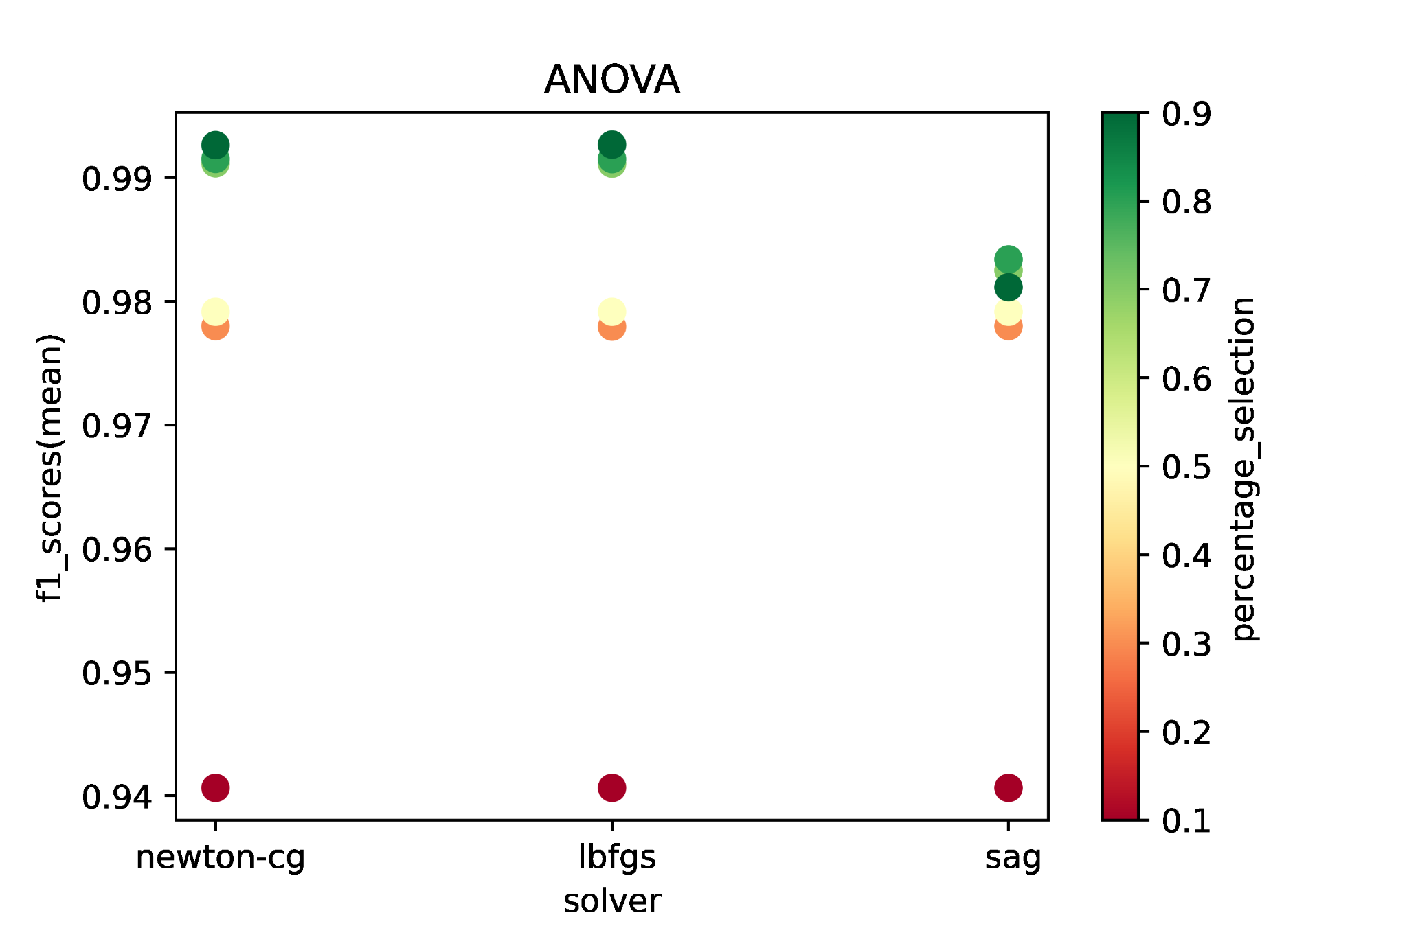
DoS - Logistic Regression
Conclusion: ANOVA + newton-cg/lbfgs + Higher percentage => Higher f1_score

Slide 24
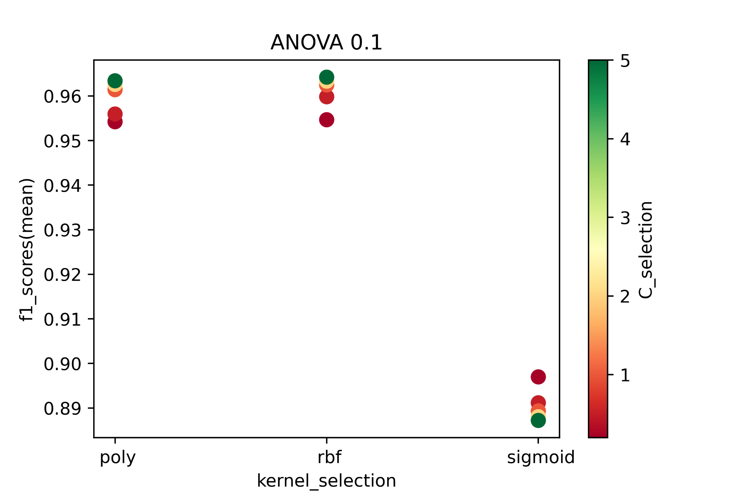
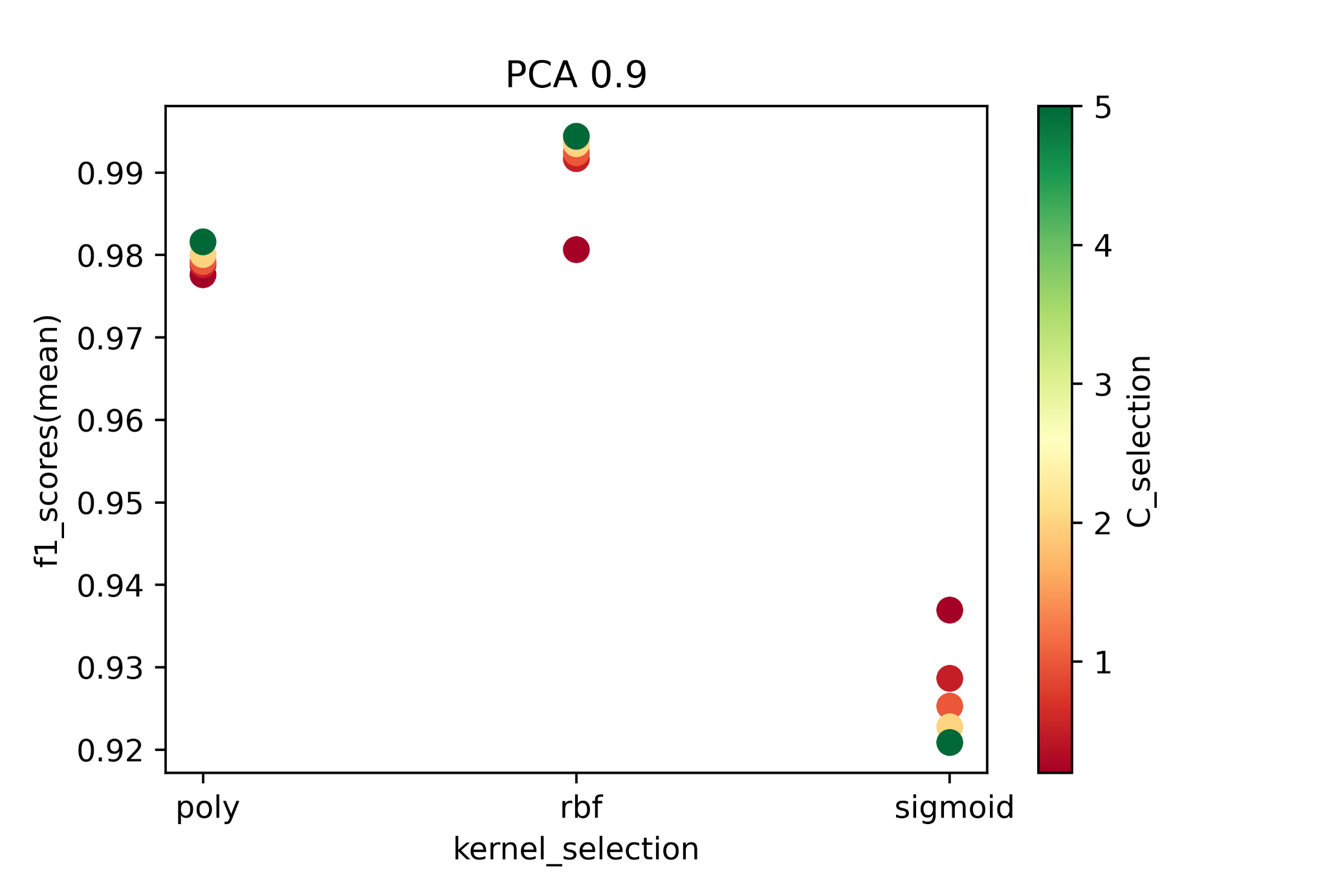
DoS - SVM
Conclusion: PCA + Higher C_selection + RBF => Higher f1_score

Slide 25
DoS - Final Models
 | Accuracy | Recall | Precision | ROC_AUC | F1 | TN FP FN TP
Decision Tree | 0.9987 | 0.9985 | 0.9983 | 0.9986 | 0.9984 | 23084 26 24 15999
Logistic Regression | 0.9936 | 0.9923 | 0.9922 | 0.9934 | 0.9922 | 22986 124 123 15900
SVM | 0.9947 | 0.9930 | 0.9941 | 0.9945 | 0.9935 | 23016 94 111 15912

Slide 26
Probe
Training set:
Total Records: 63791
Probe Records: 9846 (15.43%)
Testing set:
Total Records: 27349
Probe Records: 4231 (15.47%)
Definition: Scan for information or vulnerabilities in a network or computer system which later on will be used to attack
negative: normal
positive: ipsweep, nmap, portsweep, satan, mscan, saint

Slide 27
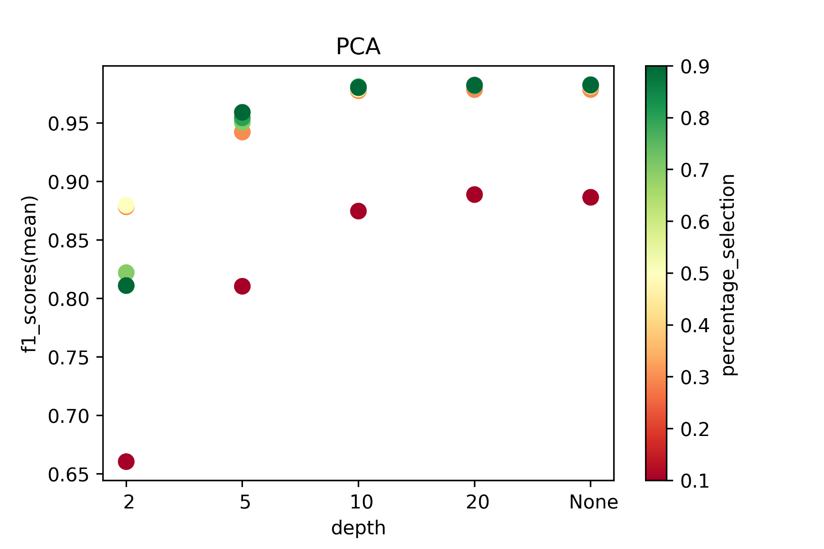
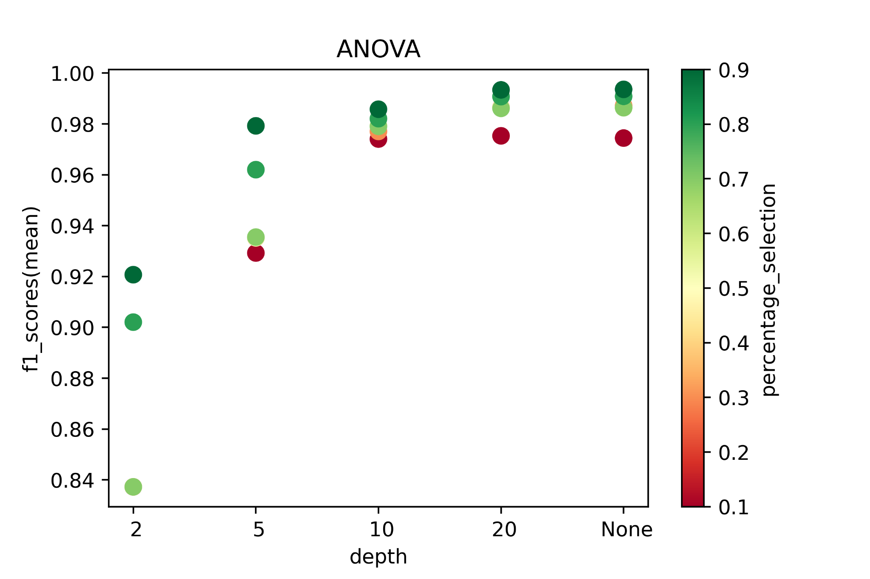
Probe - Decision Tree
Conclusion: ANOVA + Higher depth + Higher percentage => Higher f1_score

Slide 28
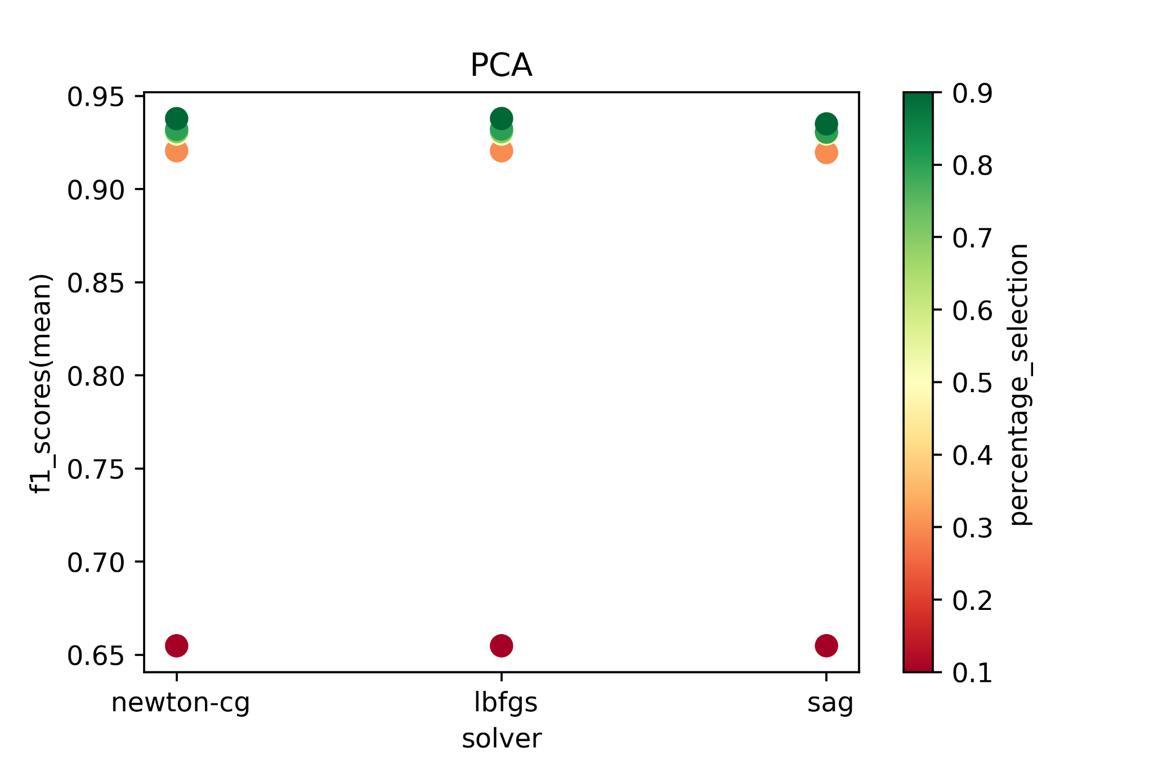
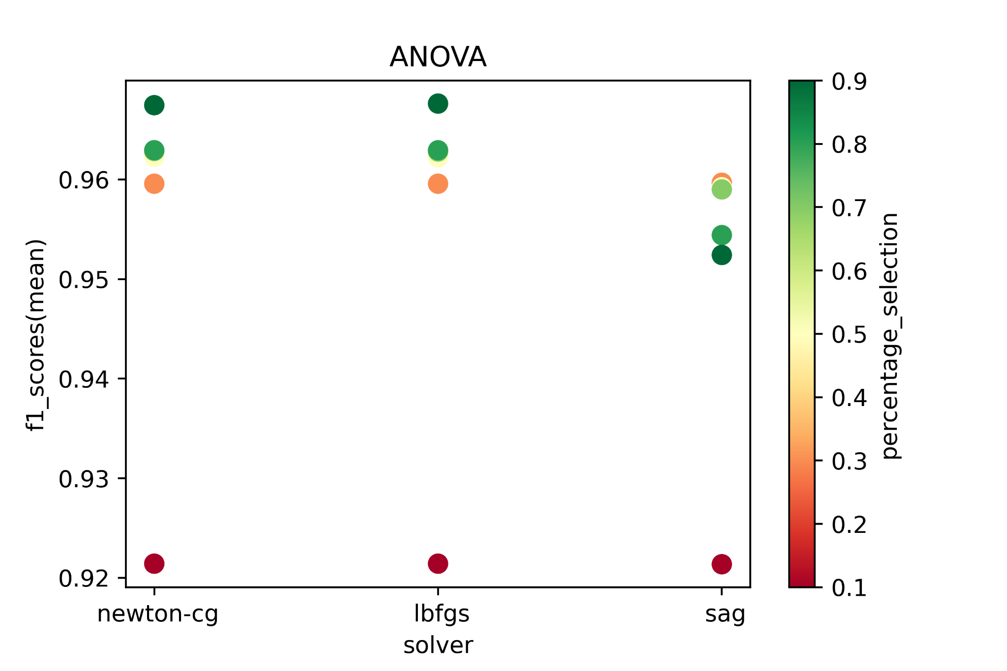
Probe - Logistic Regression
Conclusion: ANOVA + newton-cg/lbfgs + Higher percentage => Higher f1_score

Slide 29
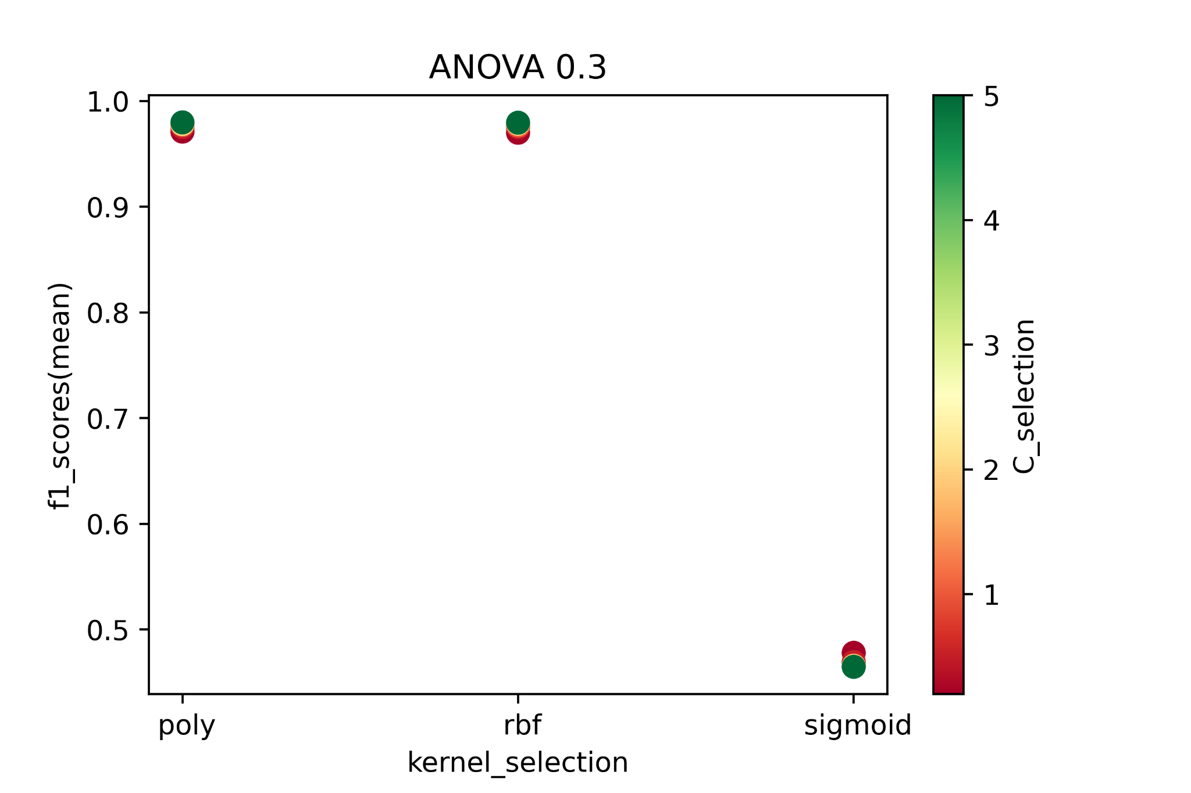
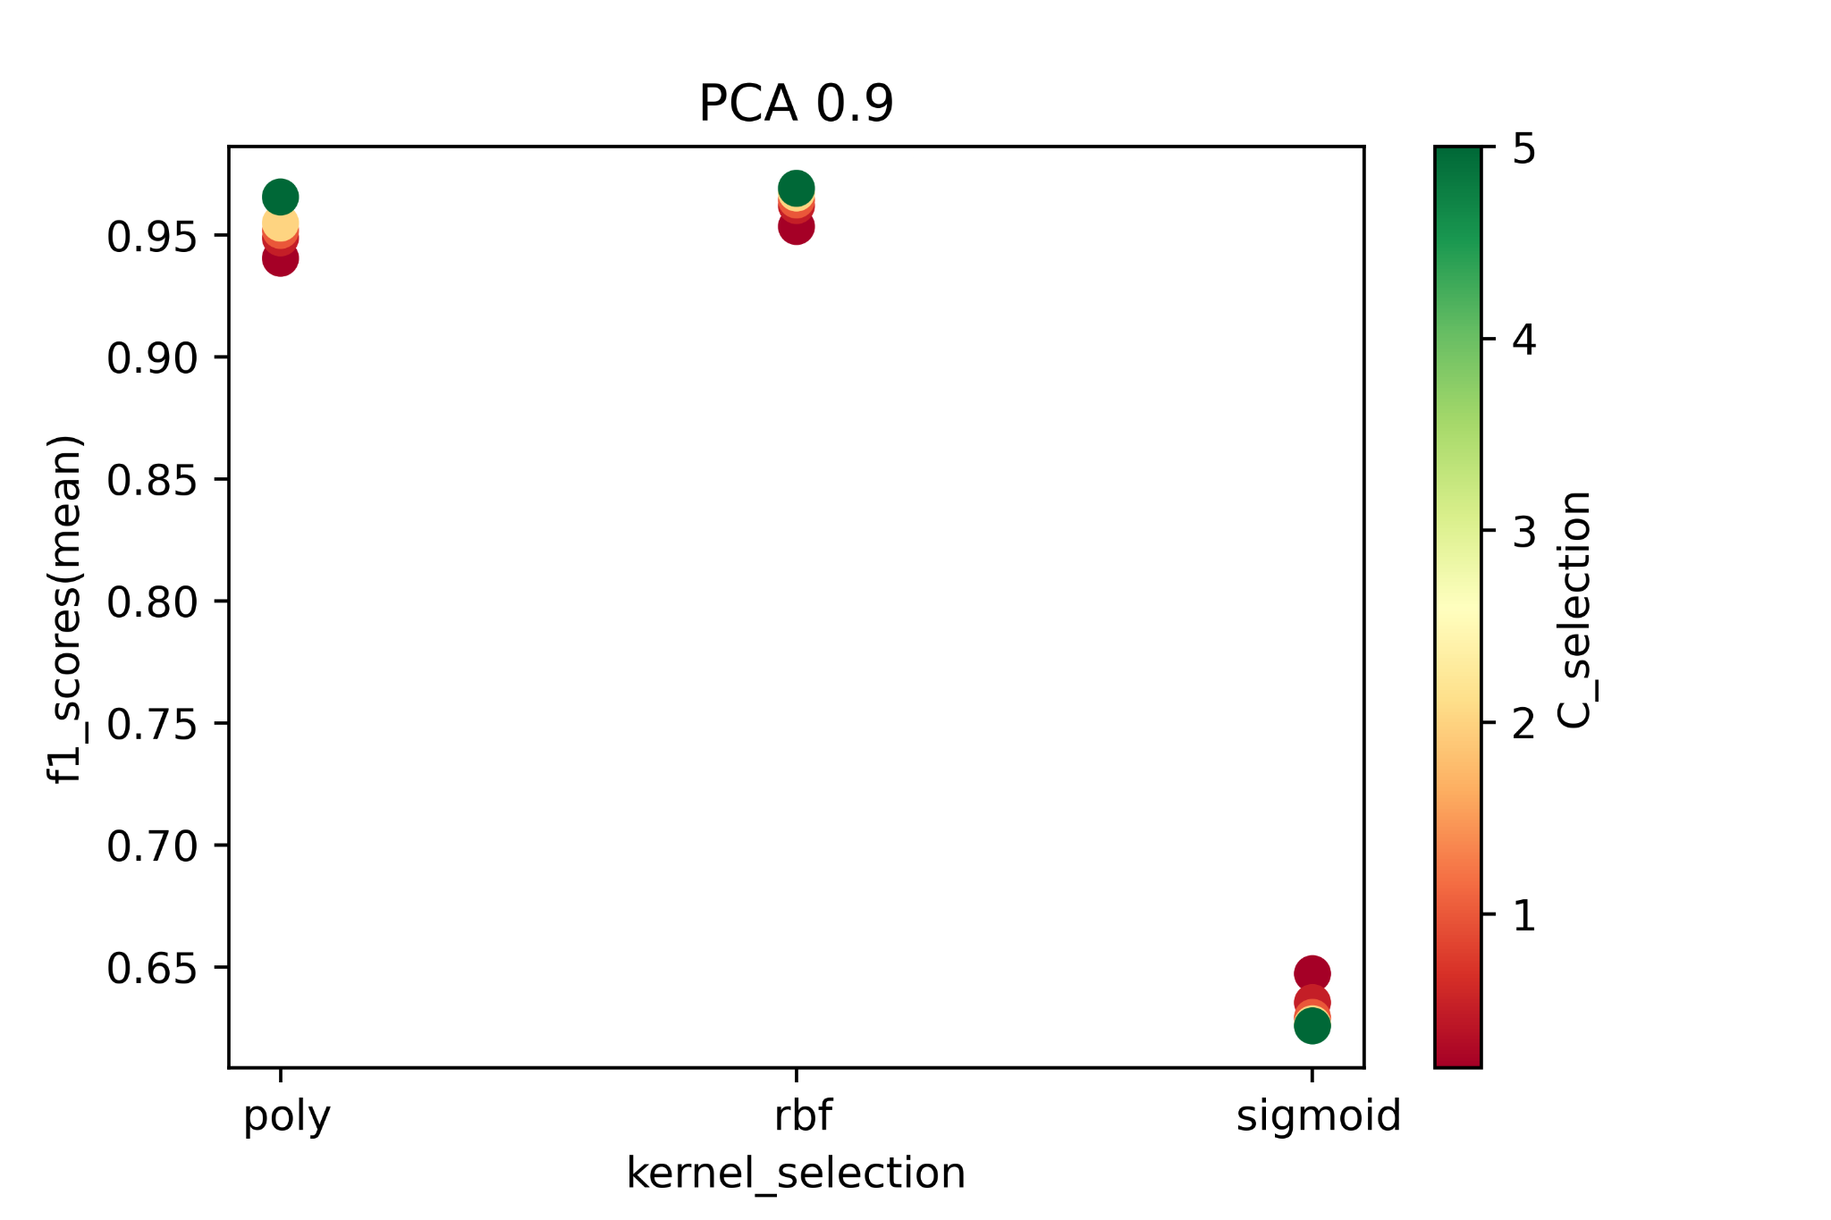
Probe - SVM
Conclusion: ANOVA+ Higher C_selection + RBF => Higher f1_score

Slide 30
Probe - Final Models
 | Accuracy | Recall | Precision | ROC_AUC | F1 | TN FP FN TP
Decision Tree | 0.9978 | 0.9929 | 0.9931 | 0.9958 | 0.9930 | 23080 29 30 4201
Logistic Regression | 0.9891 | 0.9598 | 0.9694 | 0.9771 | 0.9646 | 22981 128 170 4061
SVM | 0.9955 | 0.9896 | 0.9819 | 0.9931 | 0.9857 | 23032 77 44 4187

Slide 31
R2L (Remote to Local)
Training set:
Total Records: 56653
R2L Records: 2750 (4.85%)
Testing set:
Total Records: 24281
R2L Records: 1130 (4.65%)
Definition: Gain remotely unauthorized access to a computer system over a network by sending data packet to that system
negative: normal
positive: ftp_write, guess_passwd, imap, multihop , phf, spy, warezclient, warezmaster, sendmail, named, snmpgetattack, snmpguess, xlock, xsnoop, httptunnel

Slide 32
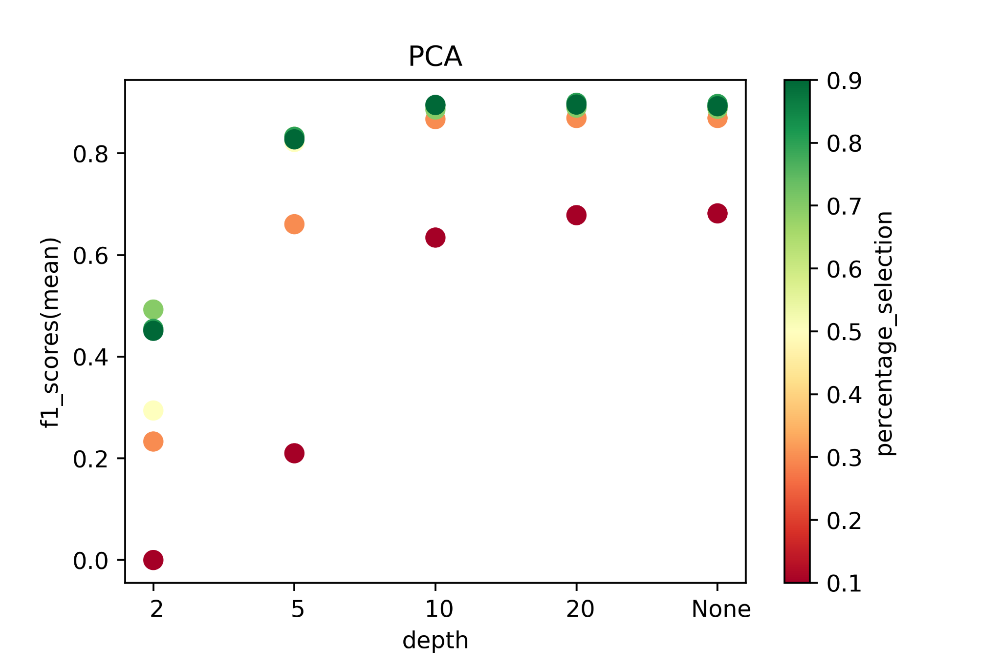
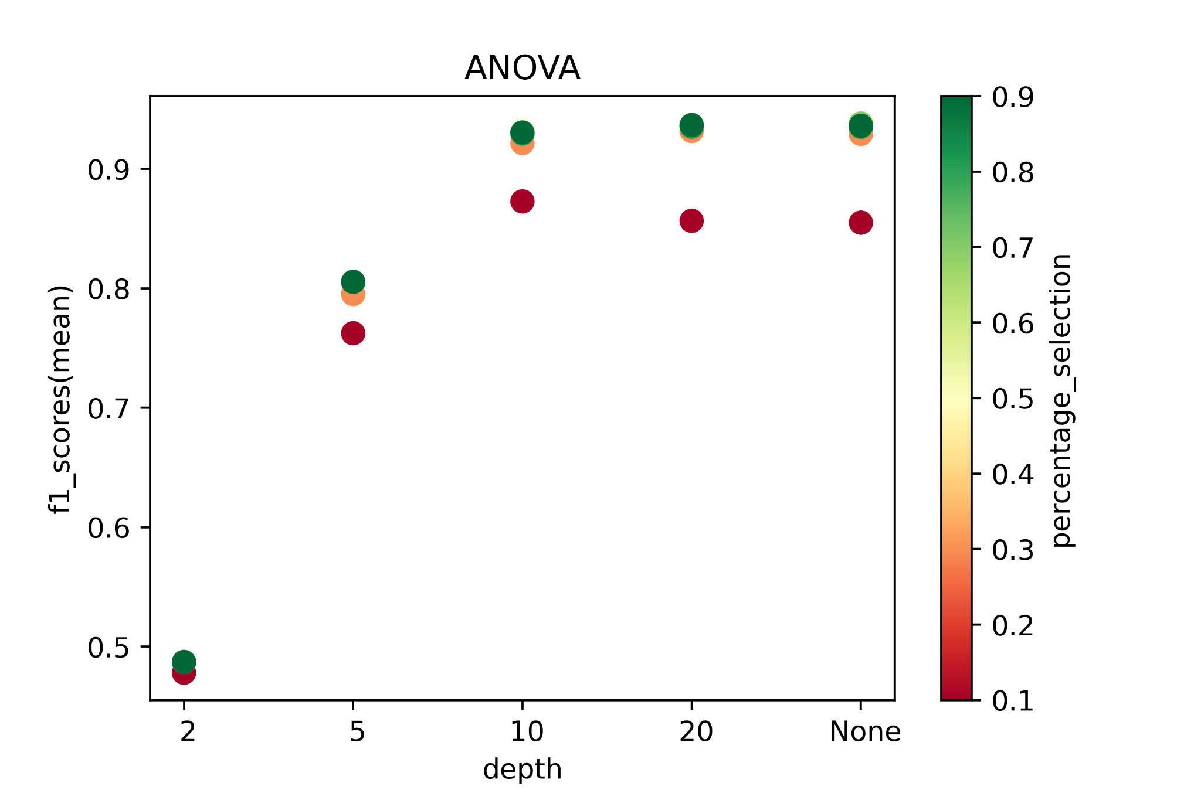
R2L - Decision Tree
Conclusion: ANOVA + Higher depth + Higher percentage => Higher f1_score

Slide 33
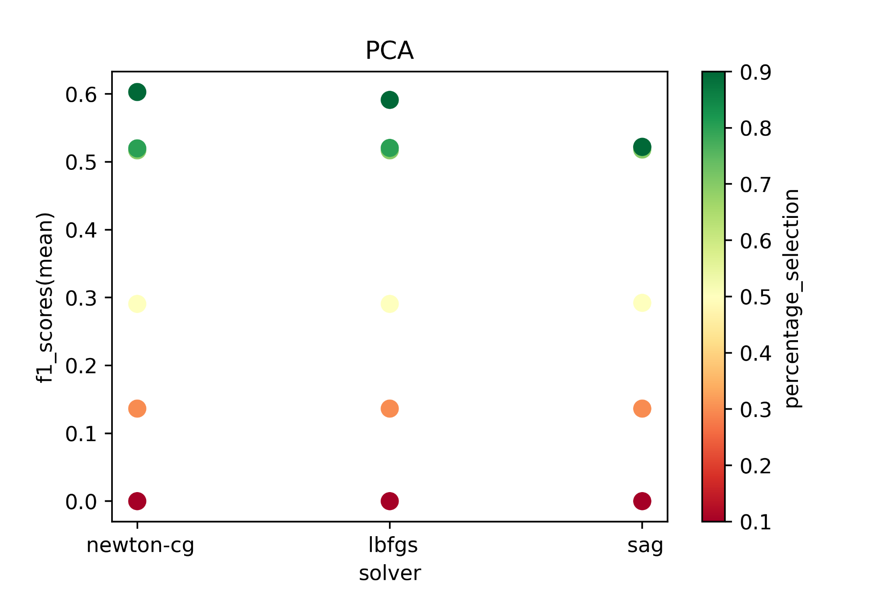
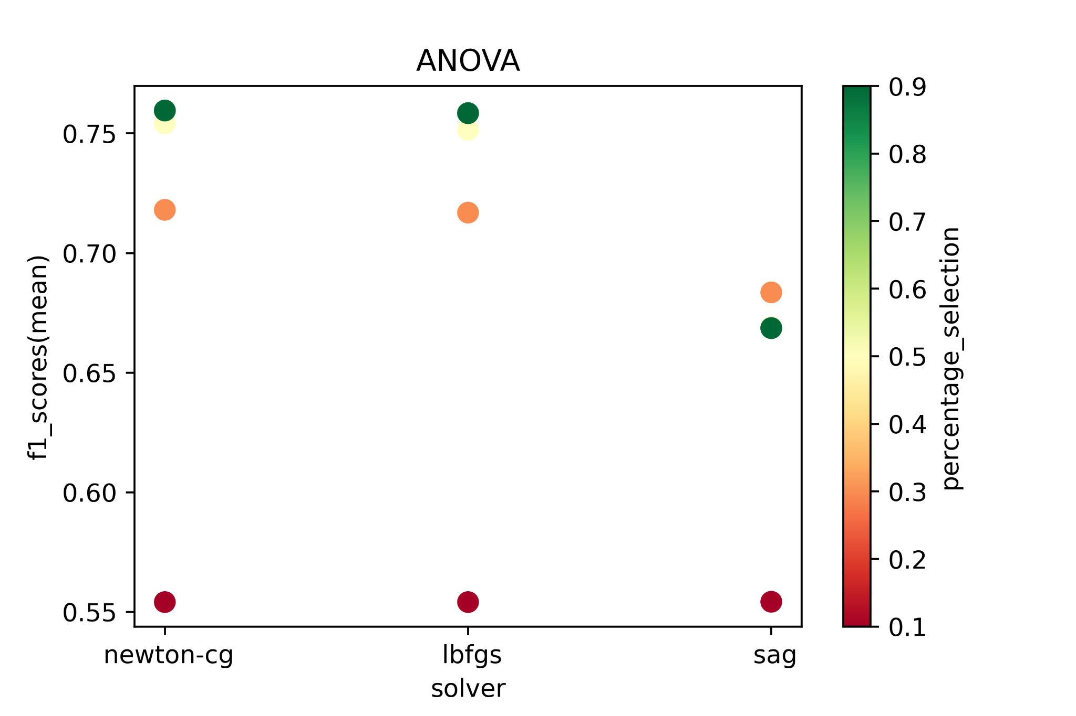
R2L - Logistic Regression
Conclusion: ANOVA + newton-cg/lbfgs + Higher percentage => Higher f1_score

Slide 34
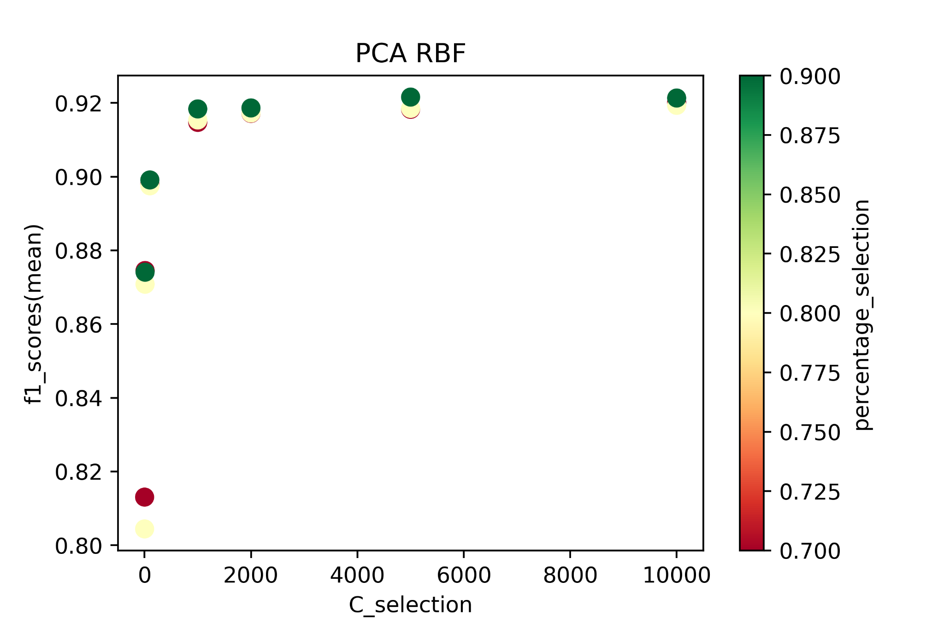
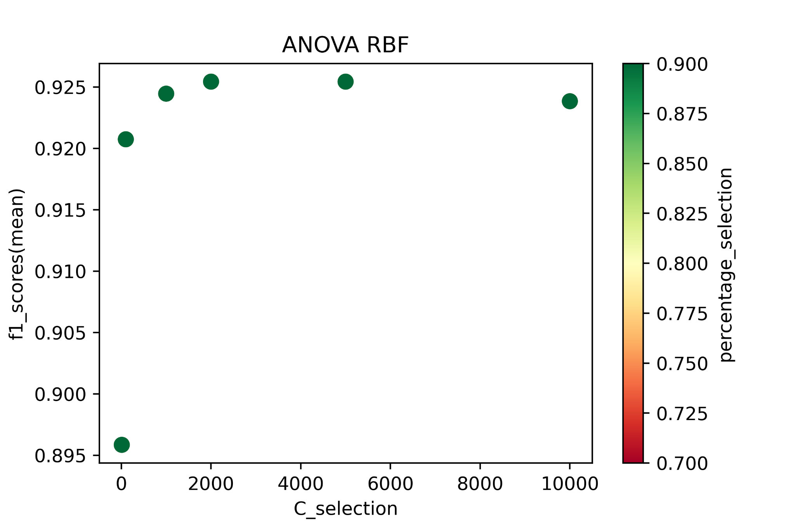
R2L - SVM
Conclusion: ANOVA + Higher C_selection + RBF => Higher f1_score

Slide 35
R2L - Final Models
 | Accuracy | Recall | Precision | ROC_AUC | F1 | TN FP FN TP
Decision Tree | 0.9943 | 0.9380 | 0.9397 | 0.9675 | 0.9388 | 23083 68 70 1060
Logistic Regression | 0.9798 | 0.7061 | 0.8356 | 0.8497 | 0.7654 | 22994 157 332 798
SVM | 0.9921 | 0.9194 | 0.9130 | 0.9575 | 0.9162 | 23052 99 91 1039

Slide 36
U2R (User to Root)
Training set:
Total Records: 54021
U2R Records: 76 (0.14%)
Testing set:
Total Records: 23152
U2R Records: 43 (0.18%)
Definition: Gain access to a user with normal privilege and later on try to access a user with administrator or root privilege
negative: normal
positive: buffer_overflow, loadmodule, perl, rootkit, ps, sqlattack, xterm

Slide 37
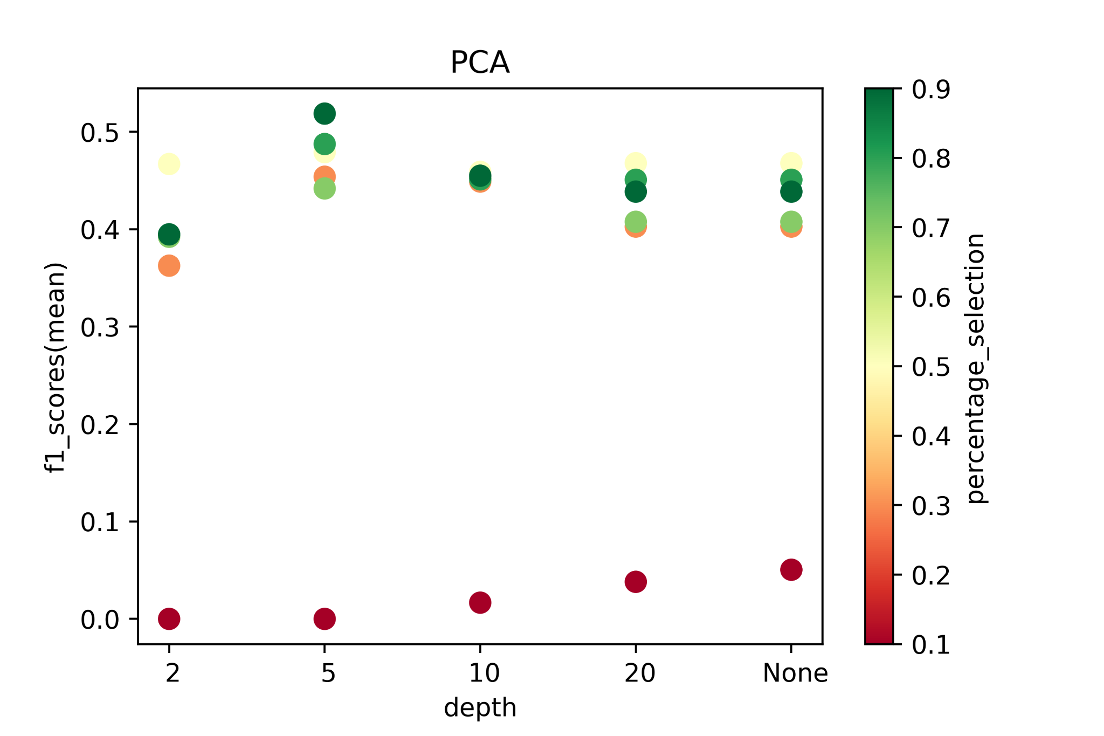
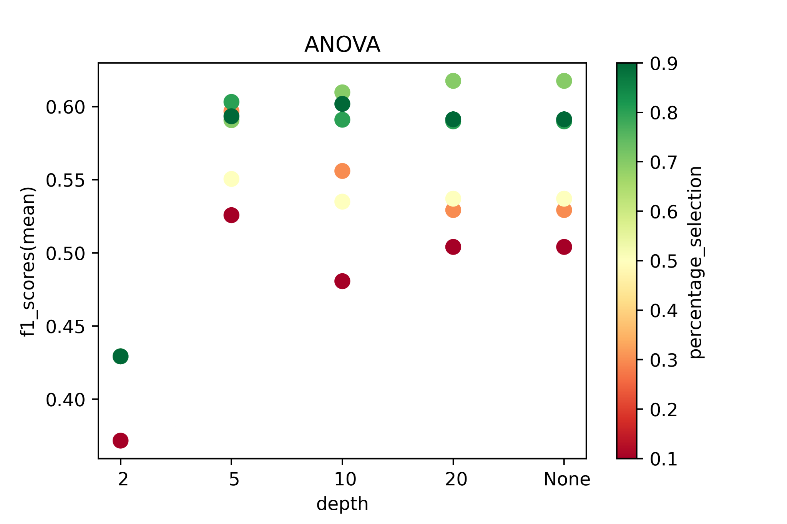
U2R - Decision Tree
Conclusion: ANOVA + Higher depth + percentage(0.5,0.6) => Higher f1_score

Slide 38
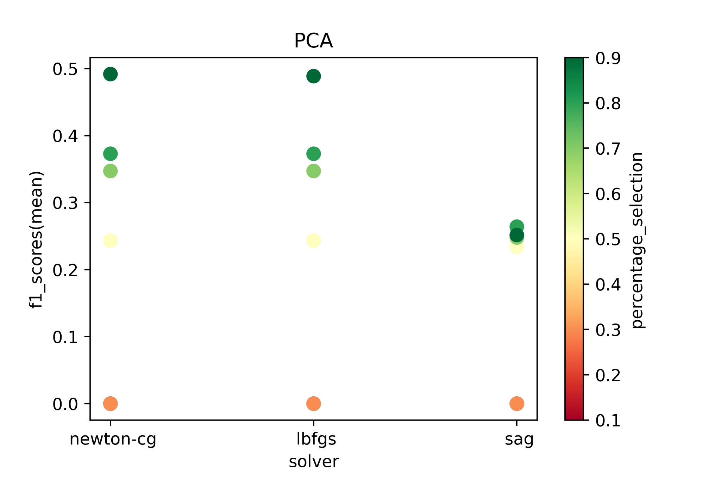
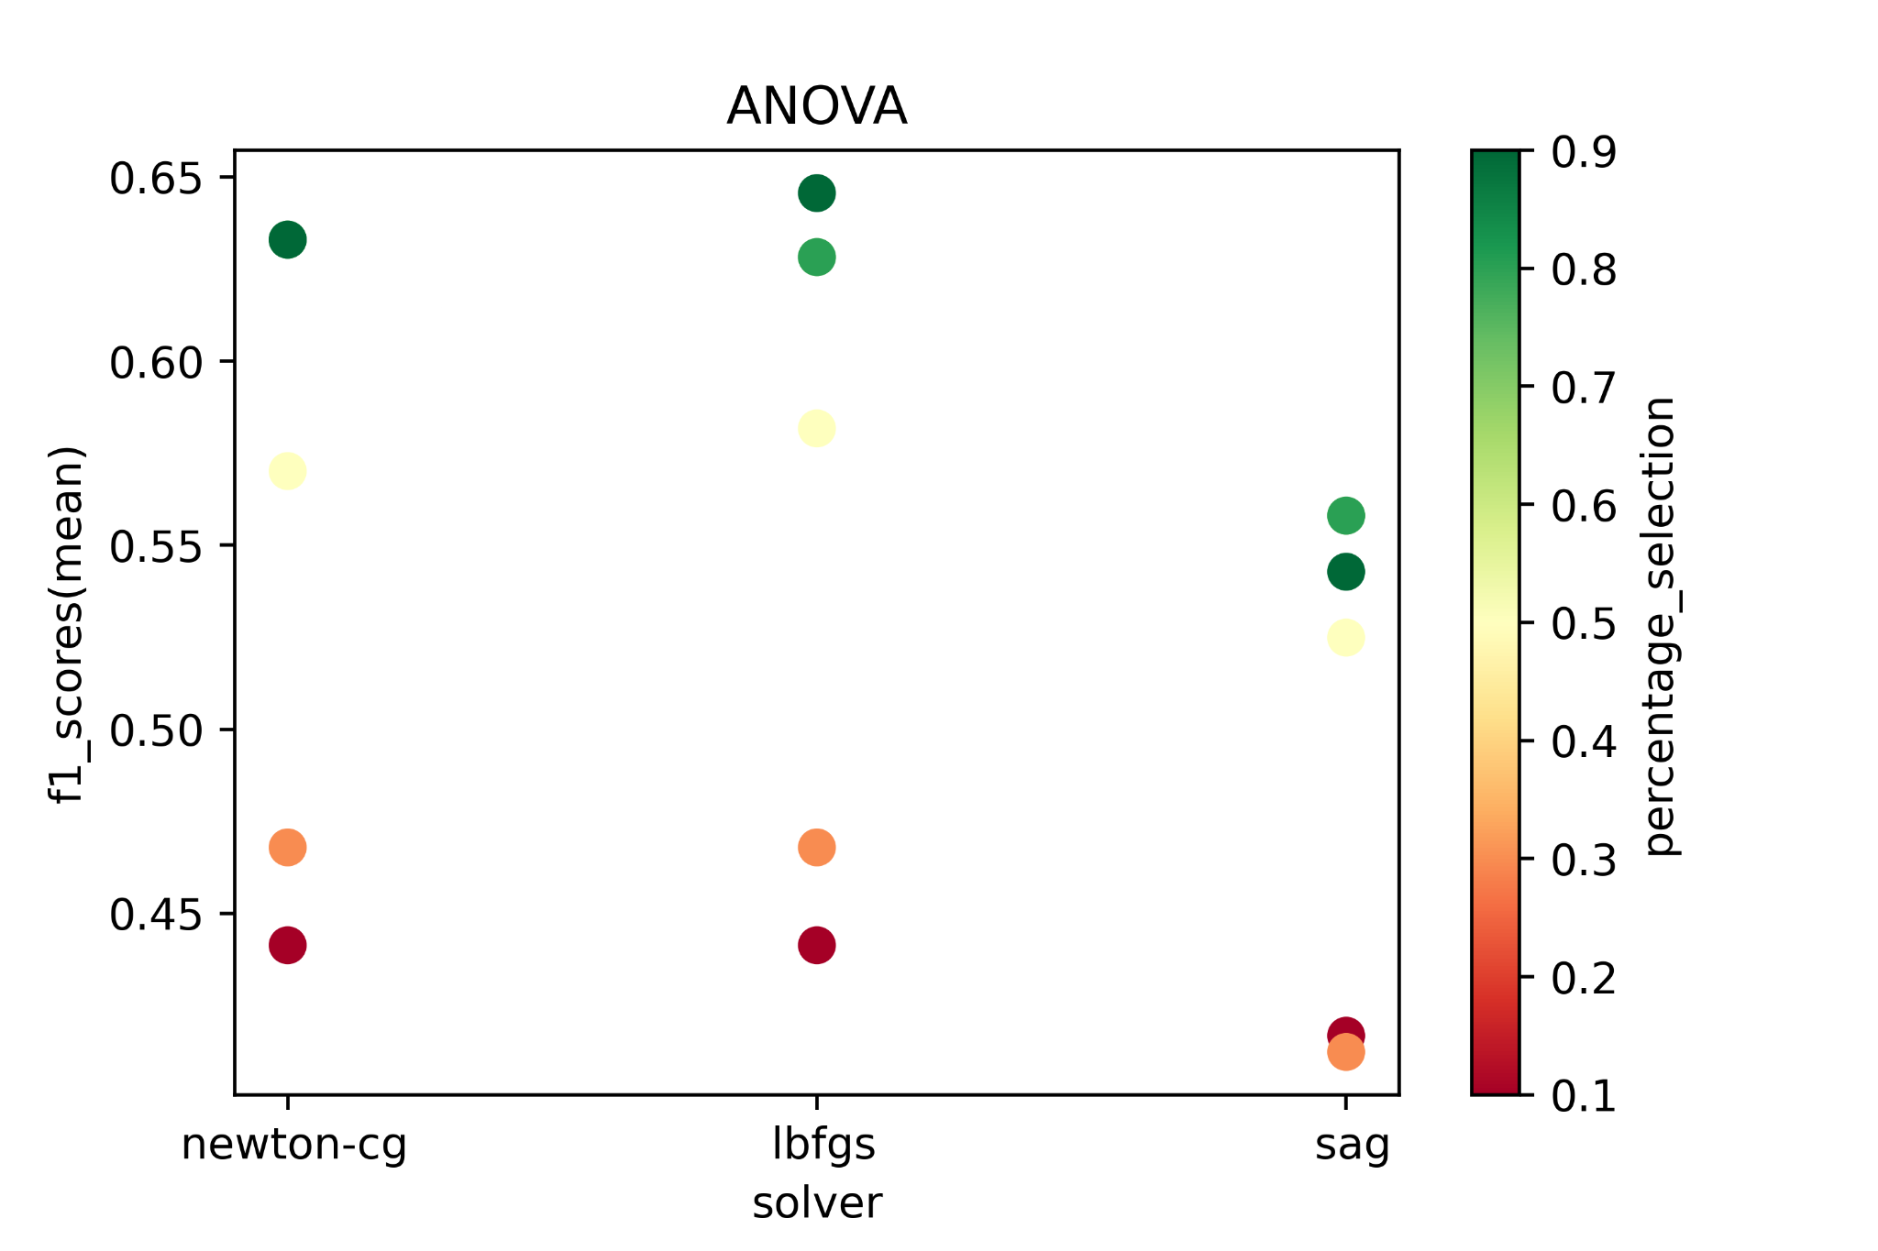
U2R - Logistic Regression
Conclusion: ANOVA + newton-cg/lbfgs + Higher percentage => Higher f1_score

Slide 39
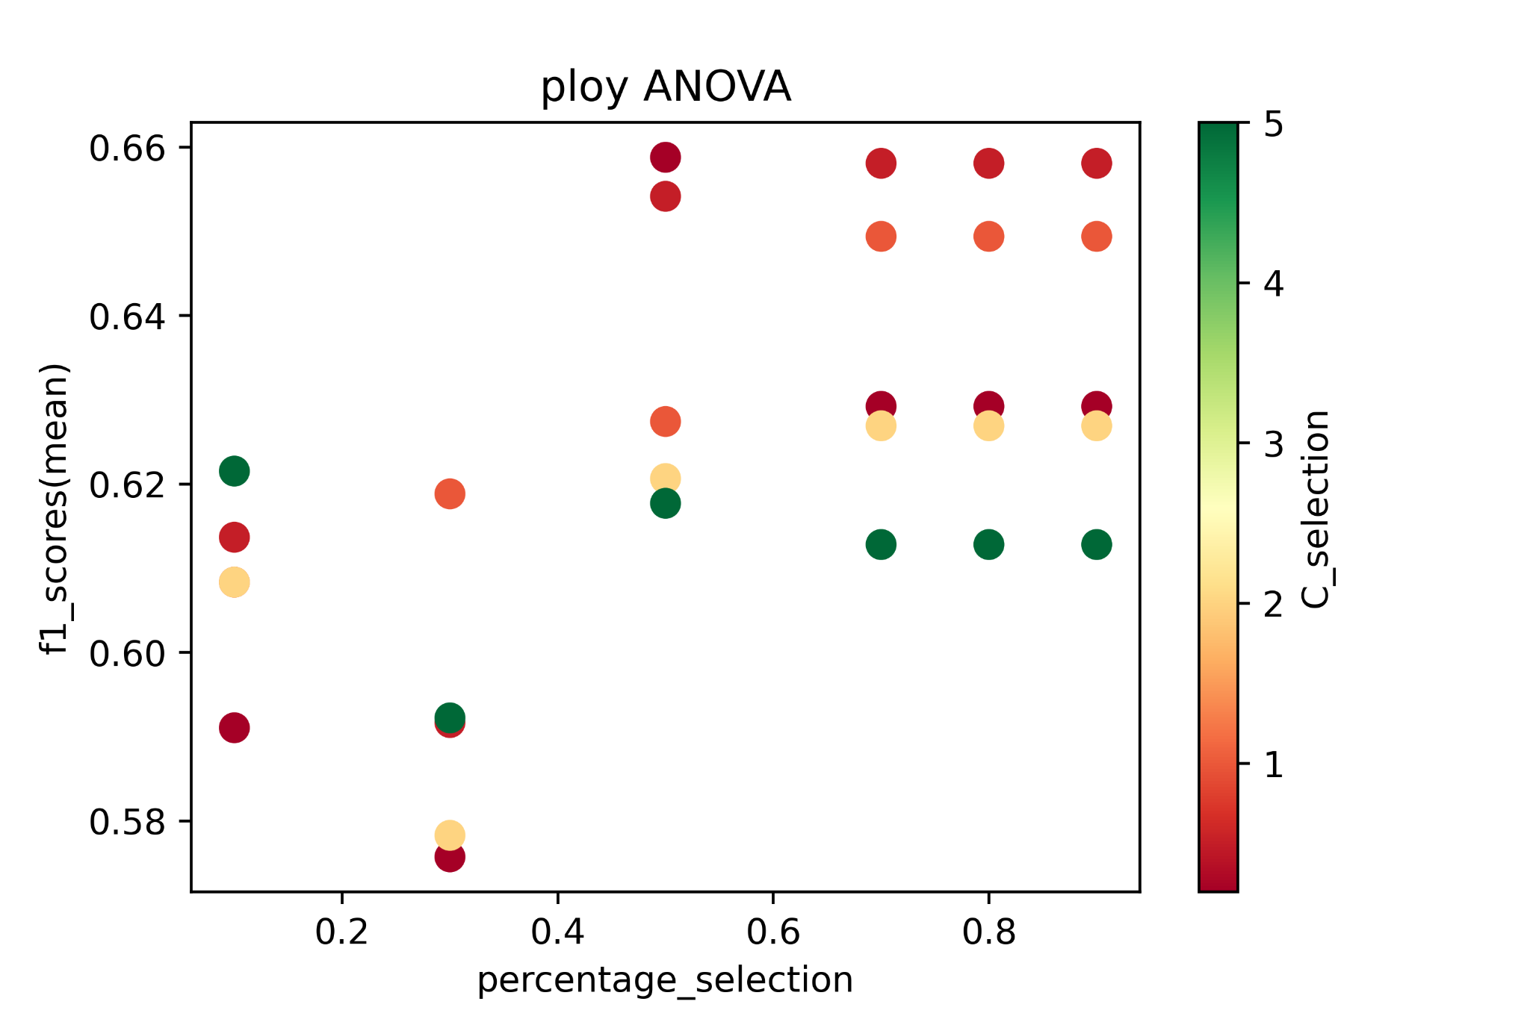
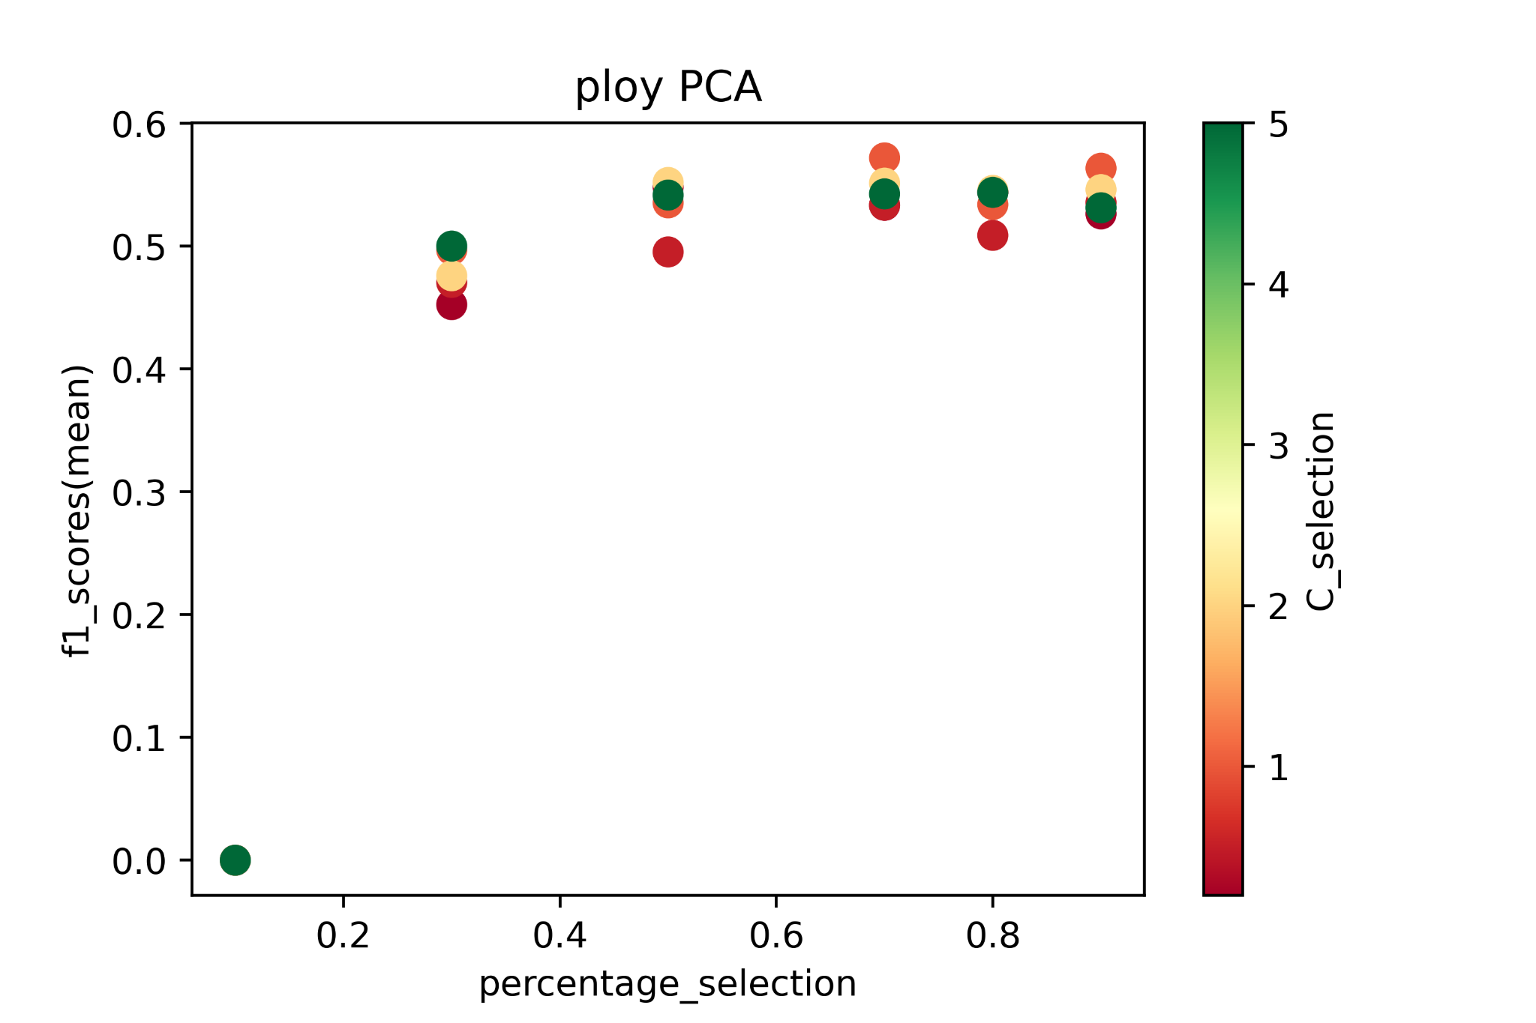
U2R - SVM
Conclusion: ANOVA + Lower C_selection + poly => Higher f1_score

Slide 40
U2R - Final Models
 | Accuracy | Recall | Precision | ROC_AUC | F1 | TN FP FN TP
Decision Tree | 0.9990 | 0.6976 | 0.7692 | 0.8486 | 0.7317 | 23100 9 13 30
Logistic Regression | 0.9987 | 0.5348 | 0.7419 | 0.7672 | 0.6216 | 23101 8 20 23
SVM | 0.9989 | 0.4883 | 0.9130 | 0.7441 | 0.6363 | 23107 2 22 21

Slide 41
Multiple Labels (Directly) - Decision Tree
Standardize
PCA/ANOVA F-test
n_component / percentile: 0.1 ~ 0.9
Cross Validate
K-Fold: 5
Decision Tree
depth: 2, 5, 10, 20, None
Evaluation
accuracy, precision, recall, f1_score, roc_auc

Slide 42
Multiple Labels (Directly) - Logistic Regression
Standardize
PCA/ANOVA F-test
n_component / percentile: 0.1 ~ 0.9
Cross Validate
K-Fold: 5
Logistic Regression
solver: newton-cg, lbfgs, sag
Evaluation
accuracy, precision, recall, f1_score, roc_auc

Slide 43
Multiple Labels (Directly) - SVM
Standardize
PCA/ANOVA F-test
n_component / percentile: 0.1 ~ 0.9
Cross Validate
K-Fold: 5
SVM
C_selection: 0.2, 0.5, 1, 2, 5, 10, 100, 1000, 10000
kernel: poly, rbf, sigmoid
Evaluation
accuracy, precision, recall, f1_score, roc_auc

Slide 44
Dataset (DoS + Probe + U2L + U2R)
Definition:
Gain access to a user with normal privilege and later on try to access a user with administrator or root privilege;
Gain remotely unauthorized access to a computer system over a network by sending data packet to that system;
Scan for information or vulnerabilities in a network or computer system which later on will be used to attack;
Block or restrict a computer system or network resources or services
negative: normal
positive: all other types
Training set:
Total Records: 103961
DoS + Probe + U2L + U2R Records:
49988(48.08%)
Testing set:
Total Records: 44556
DoS + Probe + U2L + U2R Records:
21475(48.20%)

Slide 45
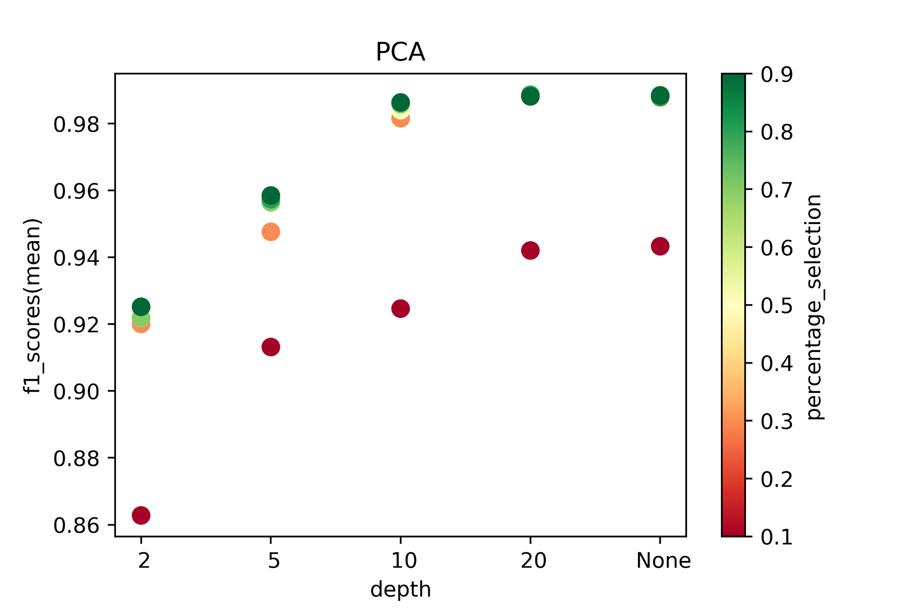
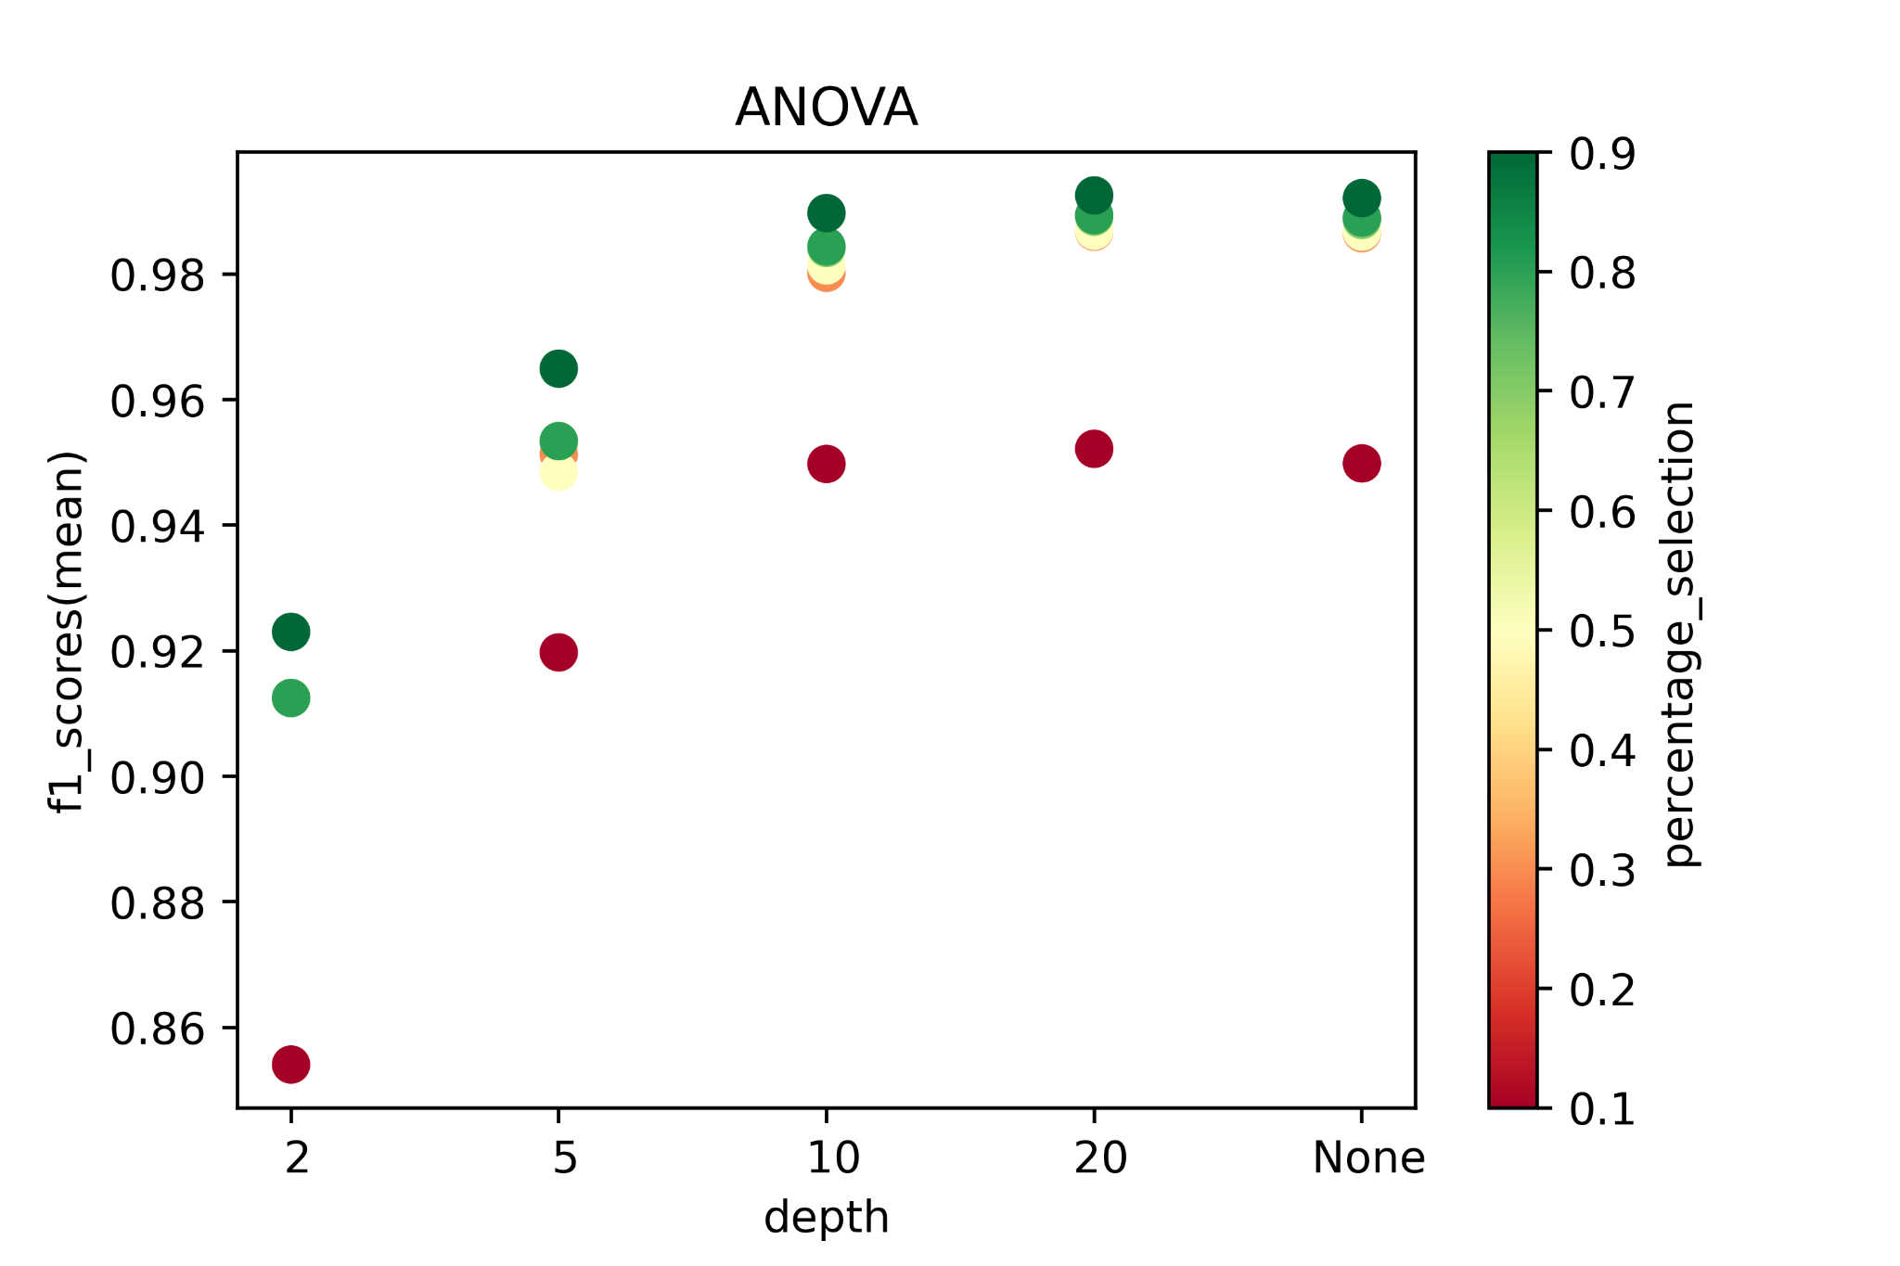
Dataset (DoS + Probe + U2L + U2R) - Decision Tree
Conclusion: Higher depth + Higher percentage => Higher f1_score; ANOVA has better results with low percentage and depth 10

Slide 46
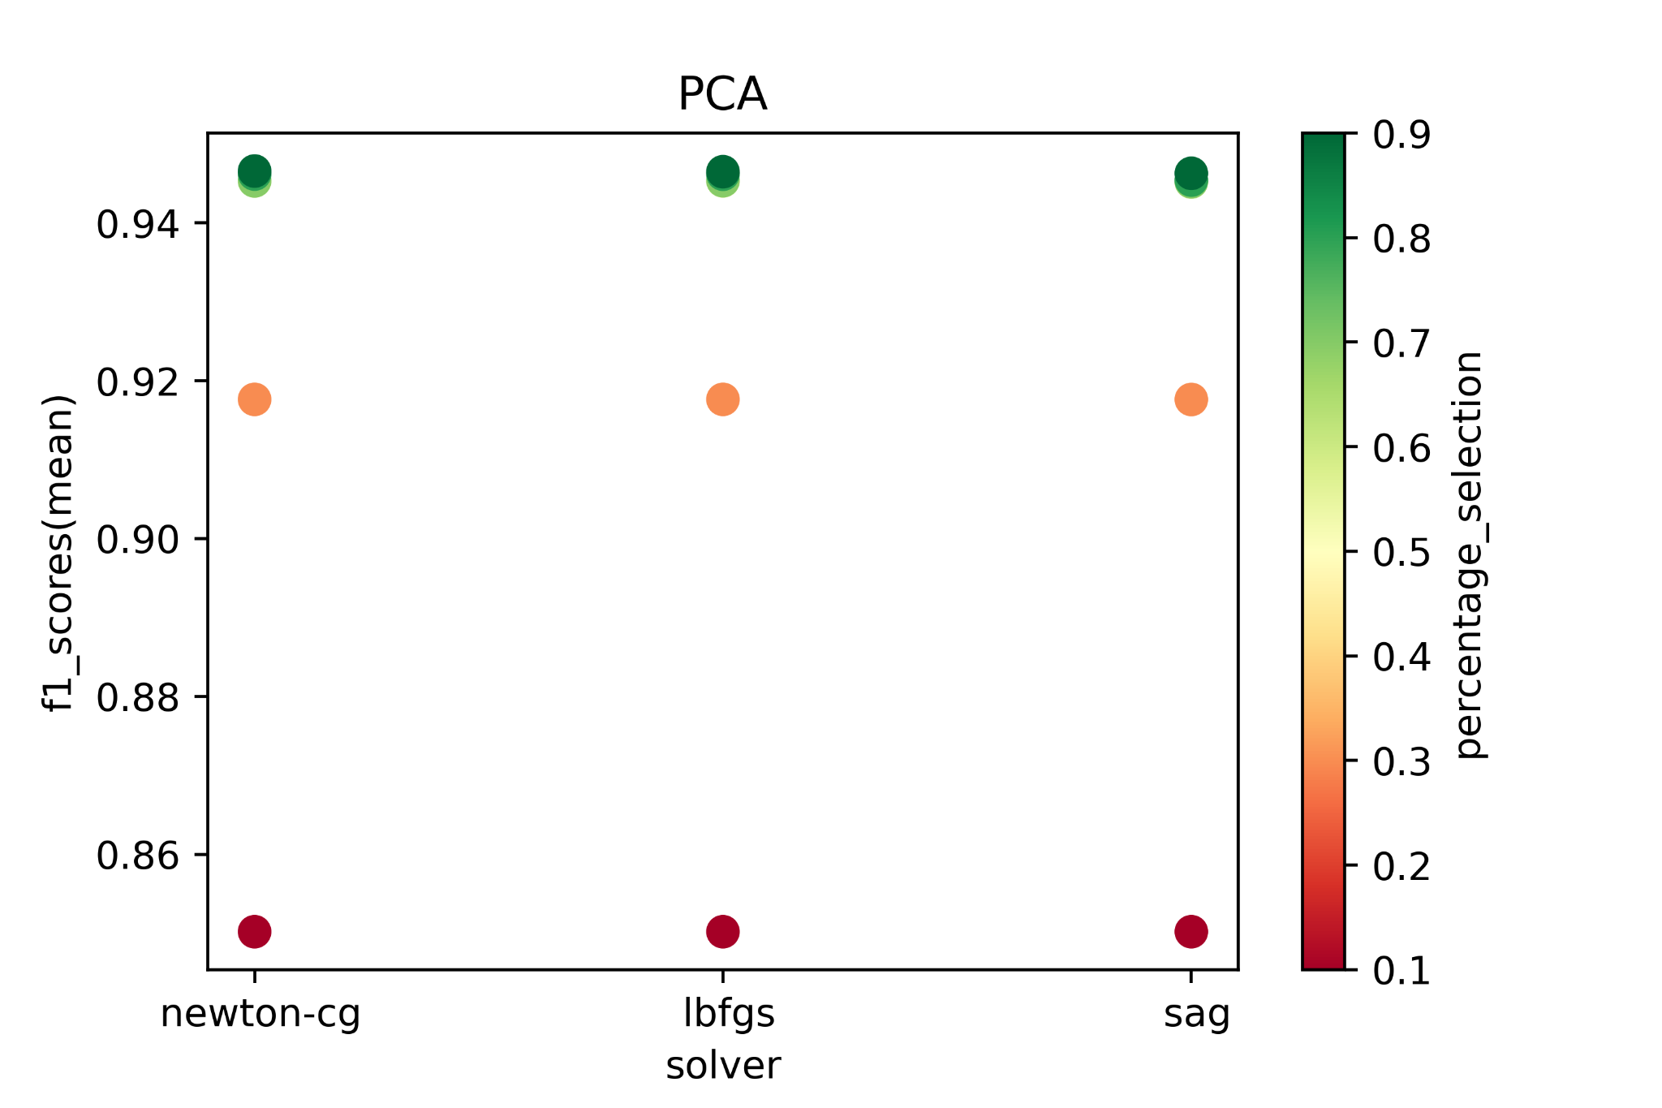
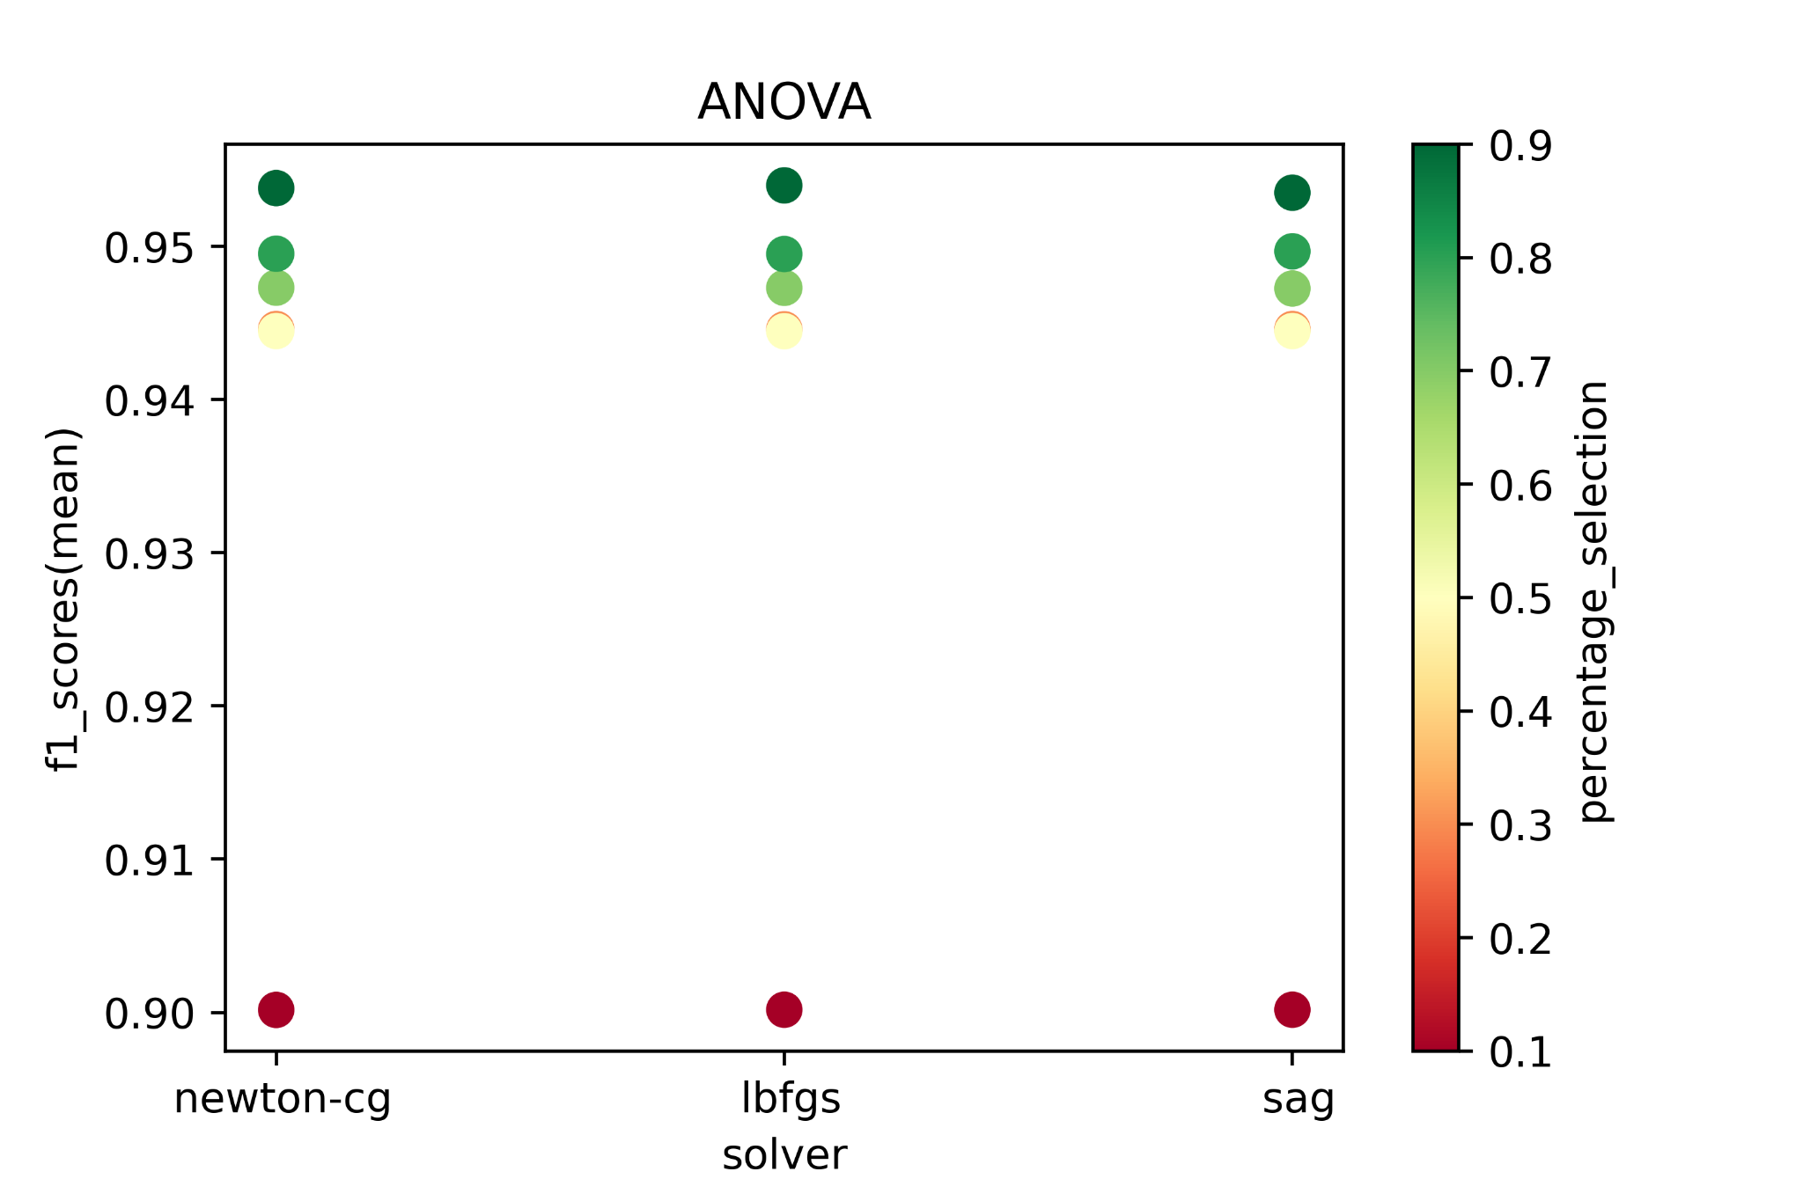
Dataset (DoS + Probe + U2L + U2R) - Logistic Regression
Conclusion: ANOVA + newton-cg/lbfgs/sag + Higher percentage => Higher f1_score

Slide 47
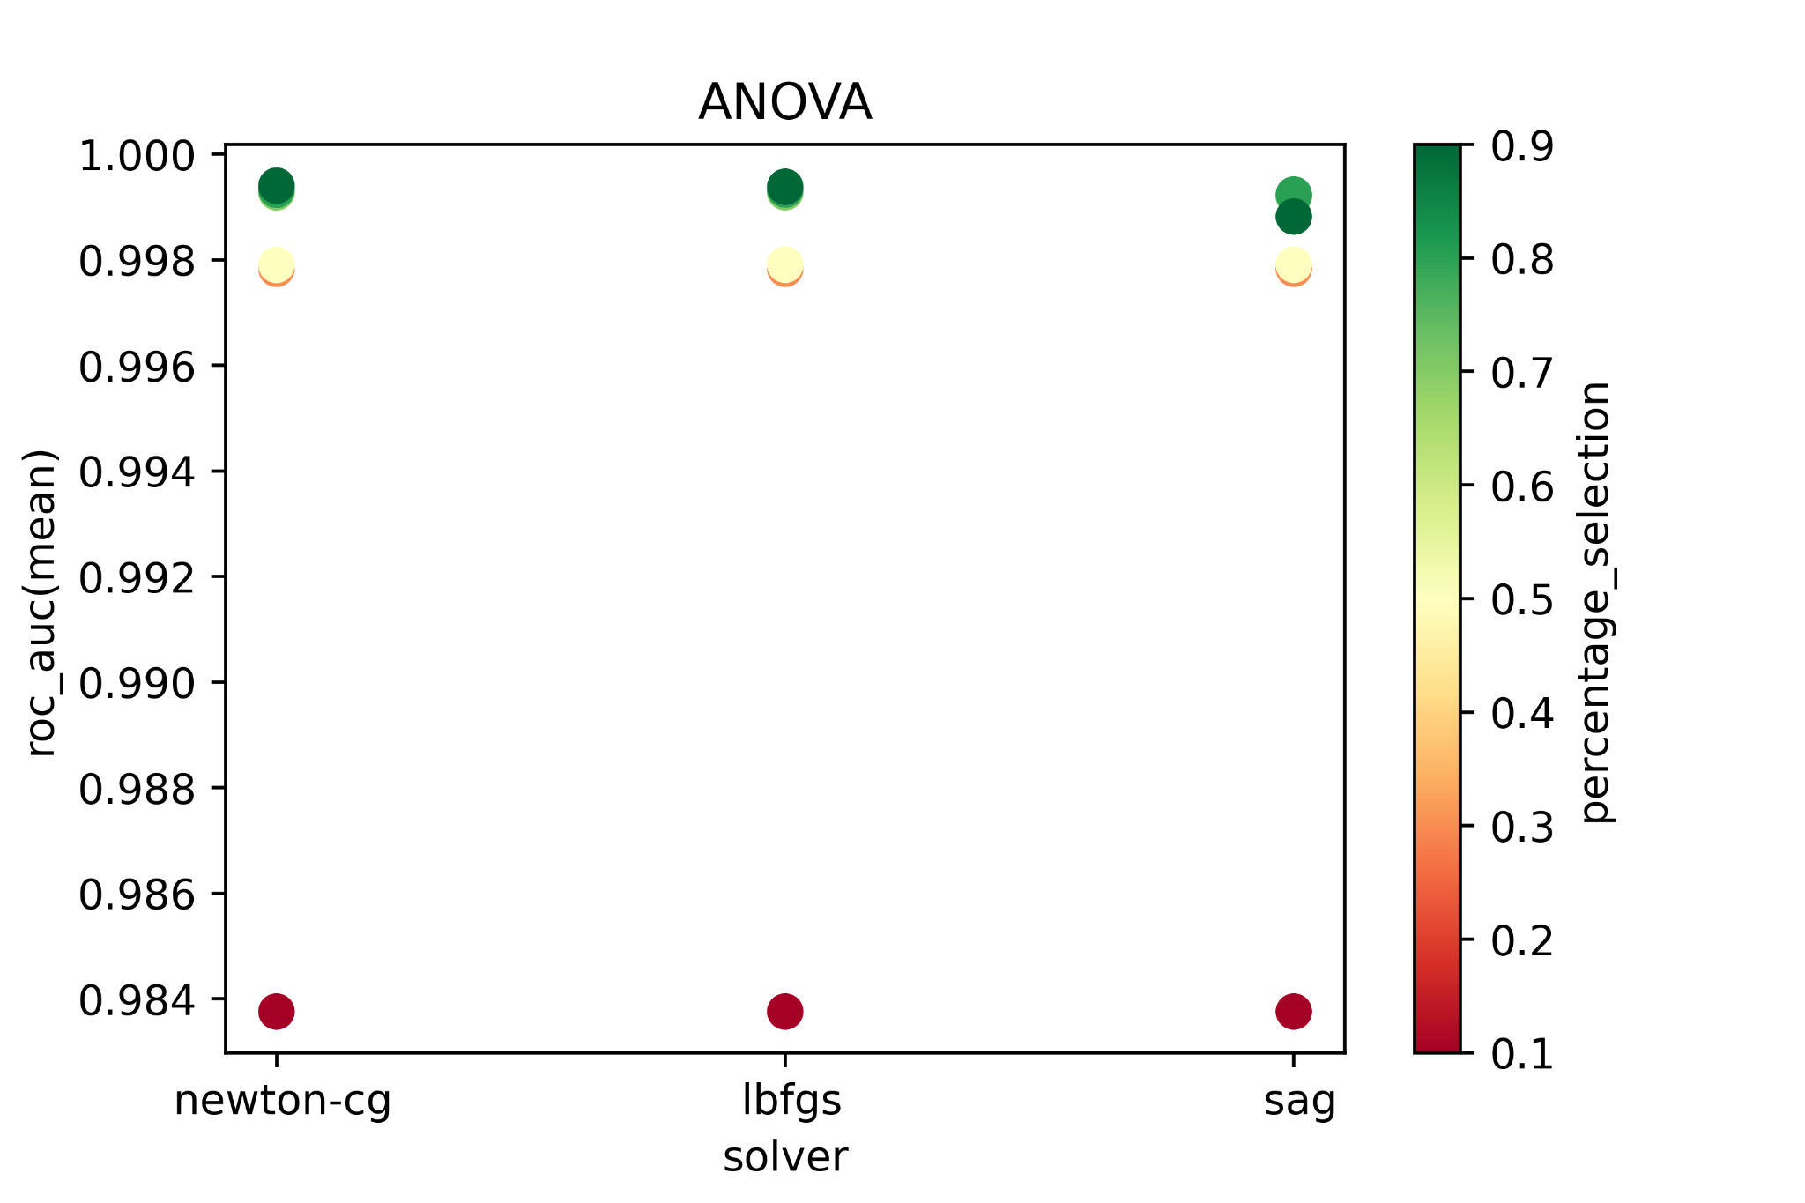
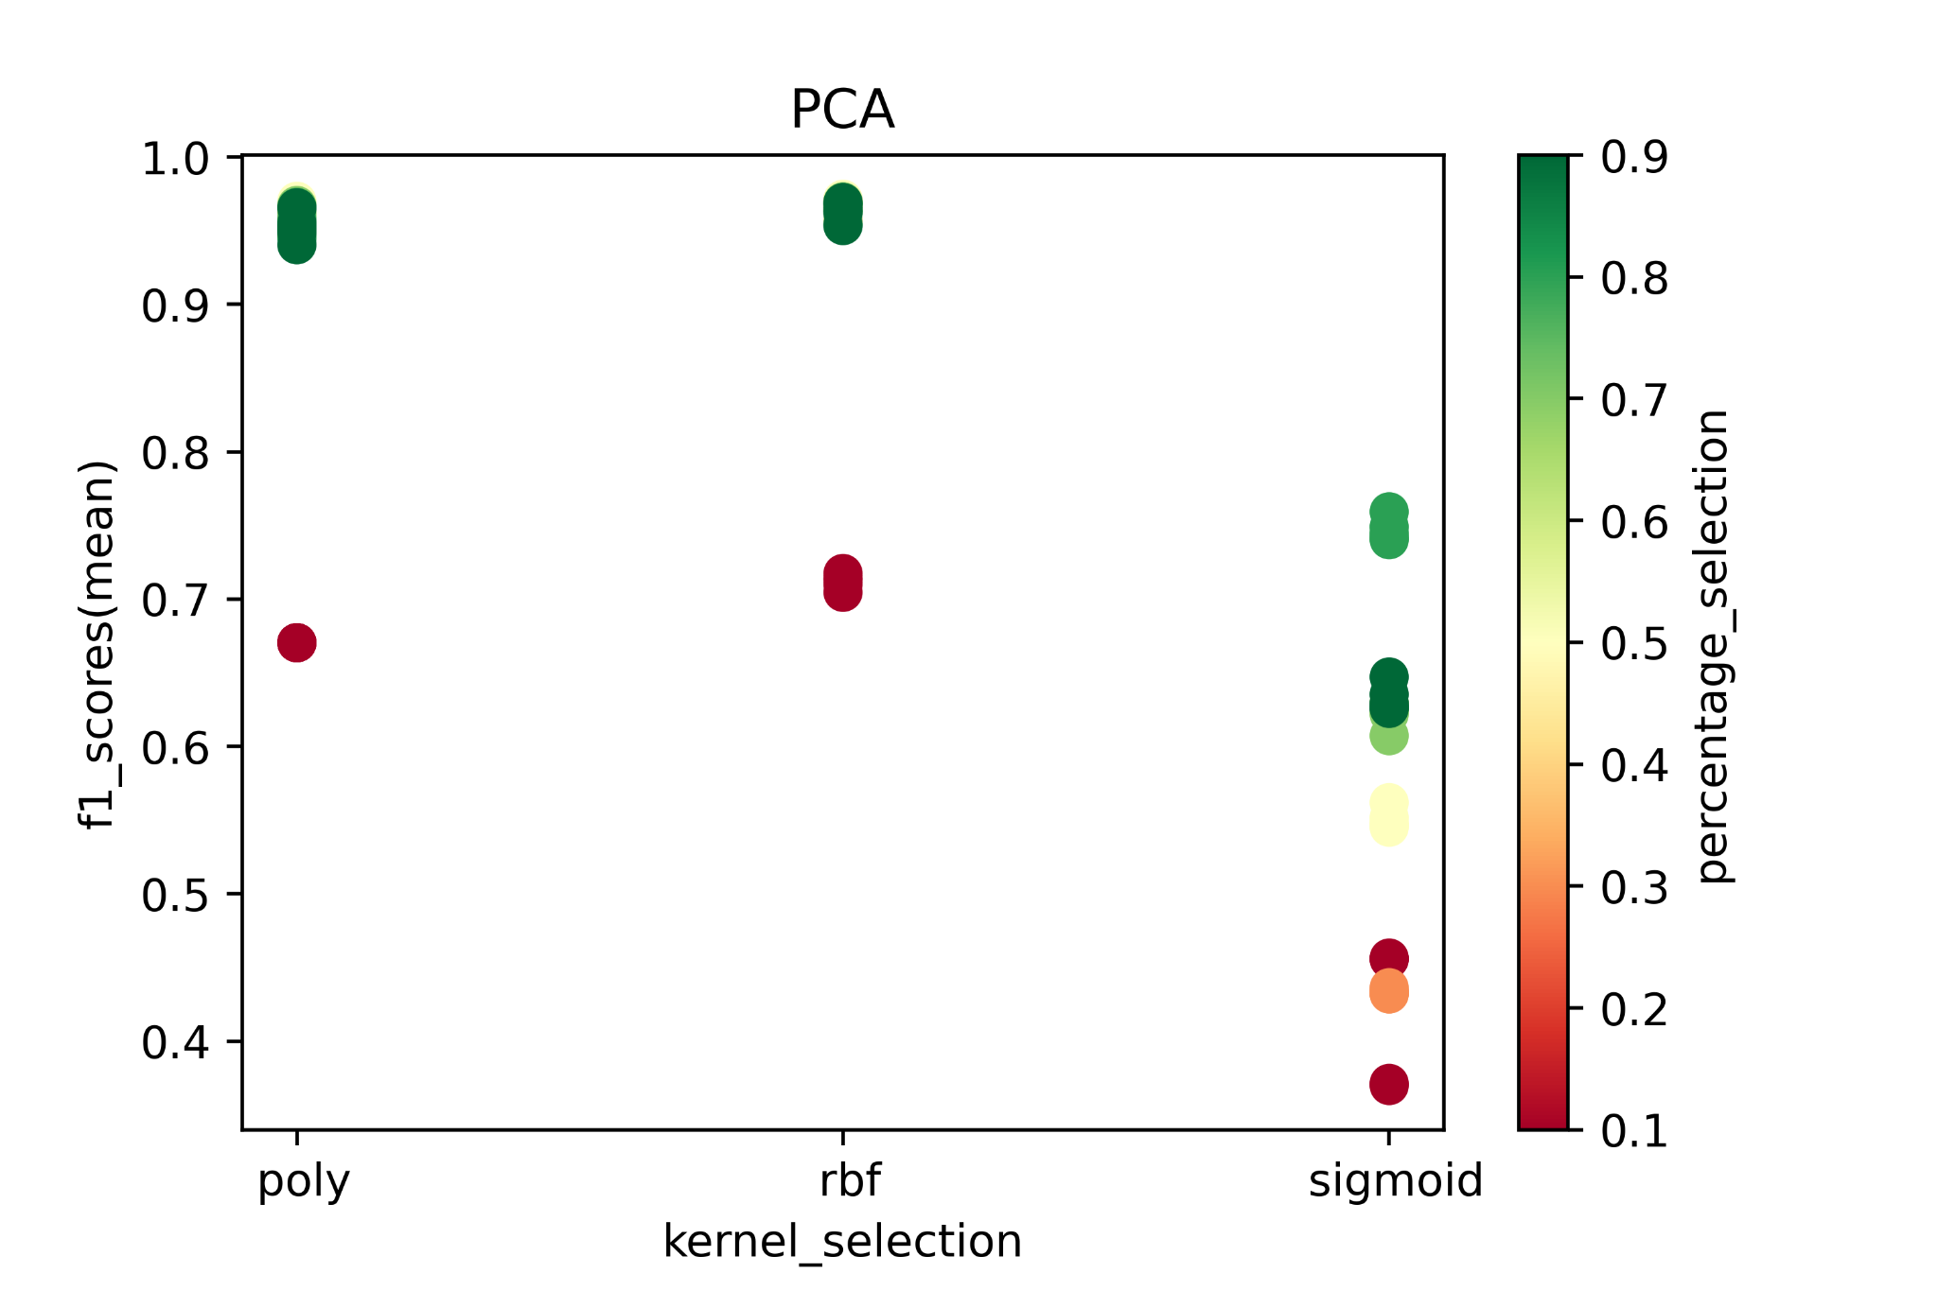
Dataset (DoS + Probe + U2L + U2R) - SVM
Conclusion: ANOVA + Higherer C_selection => Higher f1_score

Slide 48
Dataset (DoS + Probe + U2L + U2R) - Final Models
 | Accuracy | Recall | Precision | ROC_AUC | F1 | TN FP FN TP
Decision Tree | 0.9903 | 0.9900 | 0.9899 | 0.9903 | 0.9900 | 22865 216 215 21260
Logistic Regression | 0.9579 | 0.9470 | 0.9651 | 0.9575 | 0.9559 | 22345 736 1139 20336
SVM | 0.9722 | 0.9195 | 0.9130 | 0.9576 | 0.9162 | 23014 199 281 21062

Slide 49
Model Comparison
Decision Tree:
Intuitive decision rules
Easy to get relatively higher performance
Logistic Regression:
Efficient implementation
Convenient probability scores for observations
Doesn’t perform well: non-linear features
SVM:
It can be tricky to find appropriate kernel sometimes
Time consuming

Slide 50
Summary
Simple Workflow
Start with Logistic Regression to set the baseline of performance
Try Decision Tree, and see if it provide significant improvement
Try SVM if you have large number of features and number of observations with no limitation for resources and time
Unbalanced Dataset
Use penalized models
Undersampling, Oversampling, or Recursive Feature Elimination (Need to improve)

